Slide 1
Still needs work

Slide 2
P-V diagrams
Isobaric Expansion (+W)
Pressure
Isobaric Compression (-W)
Volume
The axes
Change volume?
Change pressure?
Iso = same
baric = pressure

Slide 3
P-V diagrams
Isobaric Expansion (+W)
Pressure
Isobaric Compression (-W)
Volume
W = P ΔV
ΔU = ³/₂nR Δ T = ³/₂P ΔV (not in the packet)

Slide 4
P-V diagrams
Pressure
Volume
Isochoric = same volume
(closed container)
how does it happen?

Slide 5
P-V diagrams
Pressure
Volume
W = P ΔV = 0
ΔU = ³/₂nR Δ T = ³/₂ΔPV (not in the packet)

Slide 6
Adiabatic (no heat flow) processes
Pressure
Volume
Adiabatic expansion: (Q = 0 – how?)
No heat flows in:
Q = ΔU + W
Examples
Air rockets
Cold side of fridge
Universe
Demo - cloud

Slide 7
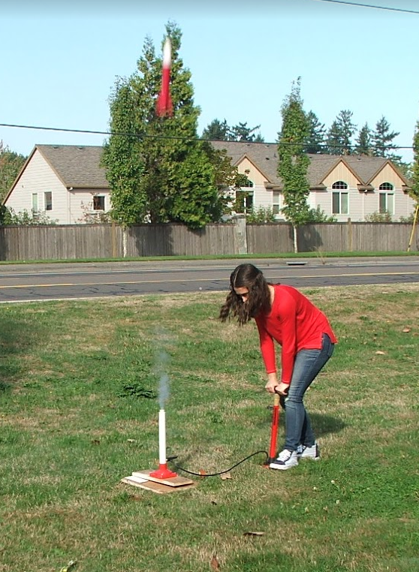
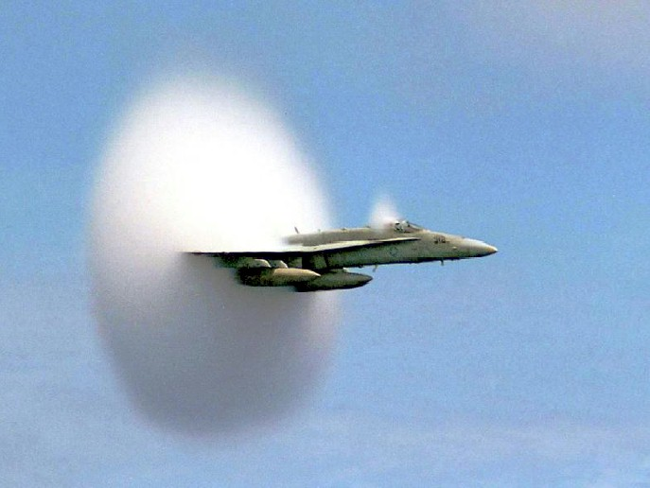

Slide 8
Adiabatic (no heat flow) processes
Pressure
Volume
Adiabatic compression: (Q = 0)
No heat flows in:
Q = ΔU + W
Examples
Bike pump/diesels
Hot side of fridge
Compressors
Demo – Fire plunger

Slide 9
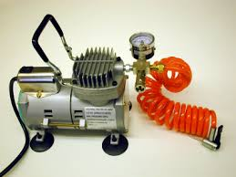
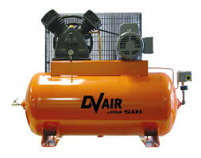
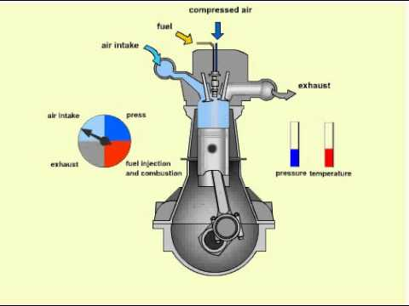

Slide 10
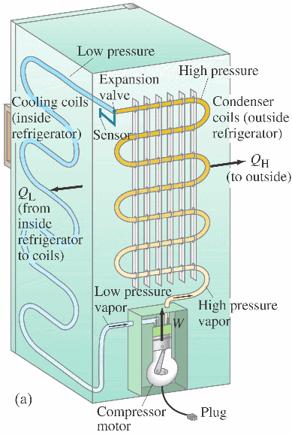
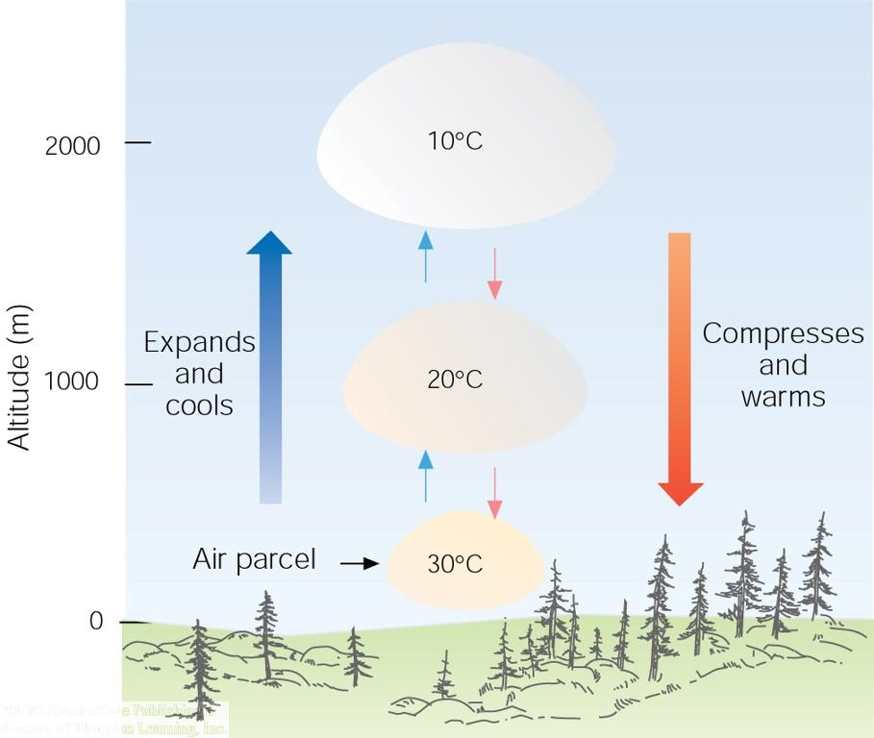

Slide 11
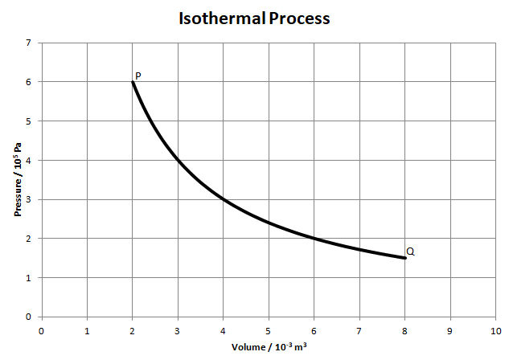
Isothermal = Constant Temperature – how?
PV = PV
Q = ΔU + W for expansion/compression

