Slide 1
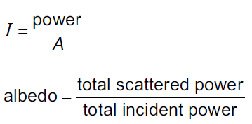
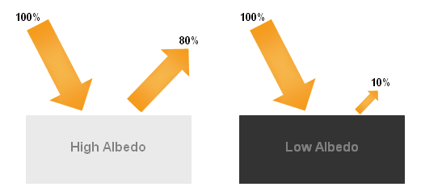
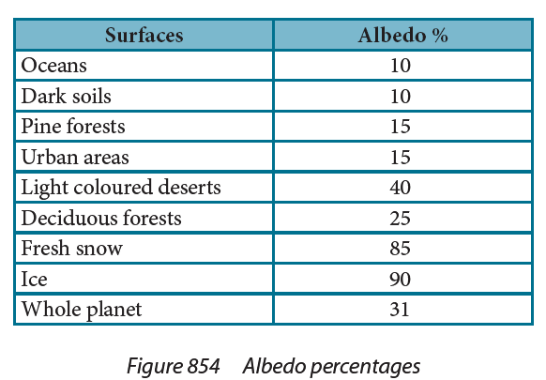
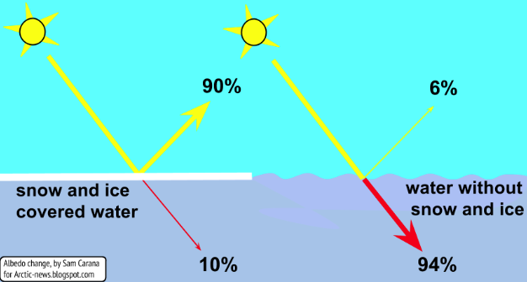
Albedo

Slide 2
Ex – Sunlight of intensity 1030 Wm⁻² shines on a solar heater with an albedo of 6.20 % (0.0620)
What is the reflected intensity? What is the absorbed intensity? (63.9 Wm⁻² , 966 Wm⁻² )
What is the power absorbed if the heater has a surface area of 16 m²? (15,500 W)

Slide 3
Try these:
On a day when the solar radiation is 980. W/m², how much power per square meter is reflected off into space from the oceans? How much is absorbed?
98.0 Wm⁻² reflected, 882 Wm⁻² absorbed
Do the same calculation for fresh snow. 833 Wm⁻² reflected, 147 Wm⁻² absorbed

