Slide 1
Conduction
Δx
dQ/dt = rate of heat flow (J/s or W)
k = thermal conductivity (W m⁻¹ ºC⁻¹ )
A = Area (m²)
ΔT = Temperature difference (ºC)
Δx = Thickness of the insulation (m)

Slide 2
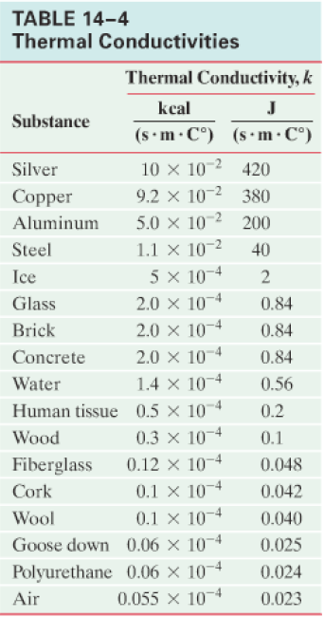
Interesting units
Why some objects feel different temperatures (When they are the same temperature)

Slide 3
Example:
A small cooler is insulated with 3.20 cm thick Styrofoam (k = 0.036 W m⁻¹ ºC⁻¹ ), and has a surface area of 1.20 m². Initially it is full of ice at 0 ºC. What quantity of ice will melt in one hour if the temperature of the outside of the cooler is kept (somehow) at 20.0 ºC.
L_{f} for water is 3.33x10⁵ J kg⁻¹.
0.292 kg

Slide 4
An engineer has a wall that measures 2.4 m tall by 5.1 m wide. They are using insulation that has a thermal conductivity of 0.024 W m⁻¹ ºC⁻¹ They want to limit the heat flow to 45.0 Watts when there is a temperature difference of 42.0 ºC from the inside to the outside. What thickness of insulation would they need to use?
0.27 m

Slide 5
A window (k = 0.84 W m⁻¹ ºC⁻¹ ) measures 2.4 m by 1.8 m and is 3.2 mm thick. In 10. minutes, 865 kJ of heat flow through the window. What is the temperature difference across the window?
1.3 ºC

Slide 6
A 72 cm by 95 cm piece of insulation is 2.54 cm thick. When there is a temperature difference of 12 ºC, the heat flow rate is 5.7 Watts. What is the thermal conductivity of the insulation?
0.018 W m⁻¹ ºC⁻¹

