Slide 1
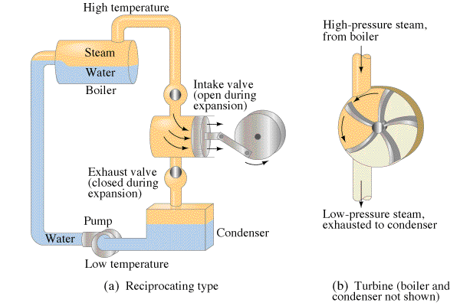
Heat engines
Turn heat to work

Slide 2
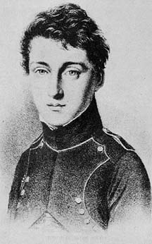
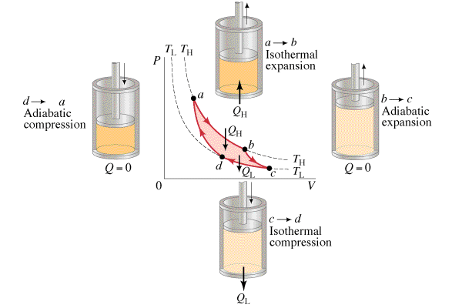
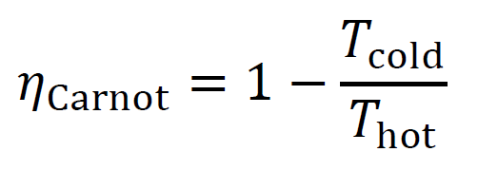
Carnot Cycle
1 June 1796 - 24 August 1832
Maximum efficiency possible

Slide 3
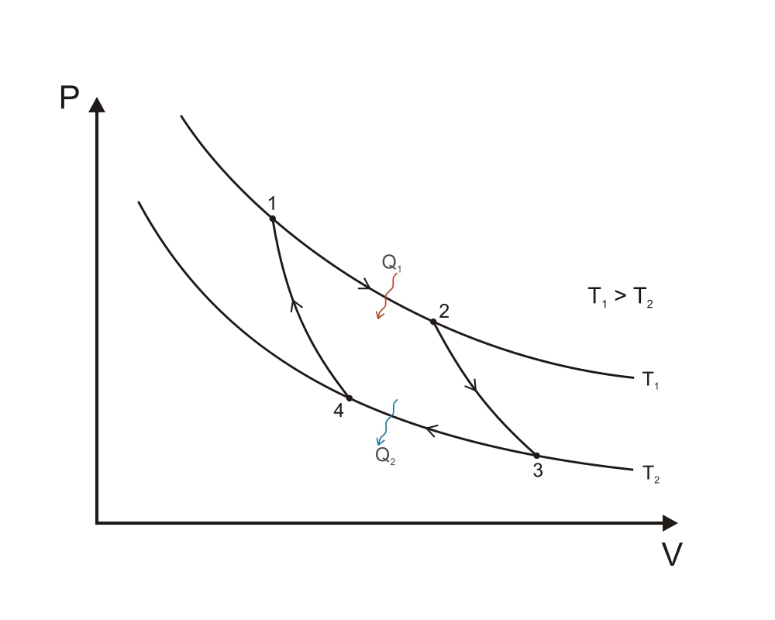
Carnot Cycle
Processes: Q = ΔU + W
1-2: Isothermal Expansion:
2-3: Adiabatic Expansion
3-4: Isothermal Compression
4-1: Adiabatic Compression

Slide 4
Carnot Cycle

