Slide 1
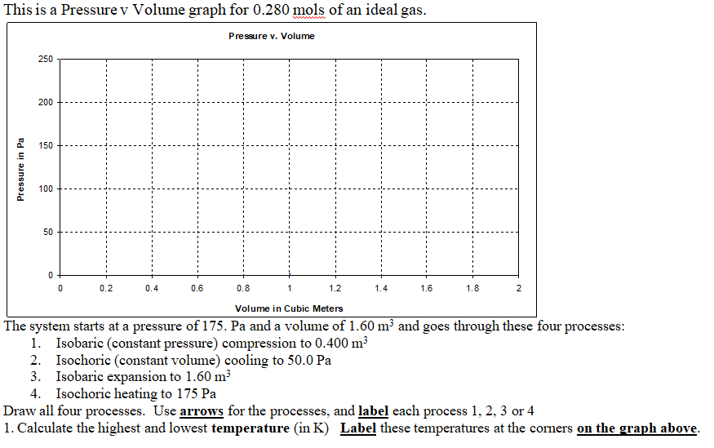

Slide 3
3. At what temperature in Celsius does 14.0 grams of Helium have a total internal energy of 9450 J? (He = 4.003 g/mol)

Slide 4
4A. 32 J of heat flow into a gas, and its internal energy drops by 17 J, how much work did the gas do? Does the temperature rise or fall? (Answer both questions)

Slide 5
4B. Fred does 35 J of work compressing a gas in a cylinder, and the internal energy rises by 13 J, what is the amount of heat flow into the gas? Does heat flow into or out of the gas? (Answer both questions)

Slide 6
5. What is the change in entropy of 1.20 kg of water boiling into vapor at 100.0 ºC? (L = 22.6x10⁵ J/kg)

