Slide 1
The four horsemen of heat transfer
Contents:
Conduction
Convection
Evaporation
Radiation

Slide 2
Conduction
Heat transfer by contact
Random wiggling
Hot to cold
Flow rate α ΔT, A, material, 1/thickness
Simulation
Insulation prevents conduction
Down/Synthetics
Thickness
Demo – Ice Melter blocks. Start the radiation demo.

Slide 3
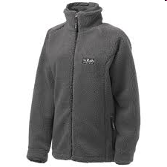
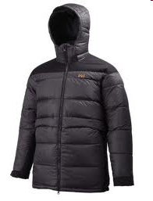
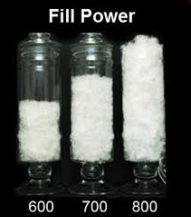
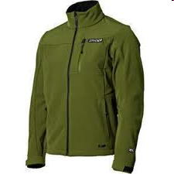
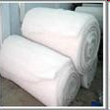
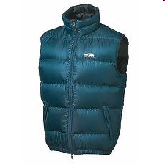

Slide 4
Convection
Heat carried away by moving fluid
Much faster than conduction
Surface layers
Examples:
Sauna/cold lake
Car radiator
Cooling fans on computers
Wind chill
Firestorms
Windbreakers slow down convection
Demo – Heat Sinks and smoke box with candle

Slide 5
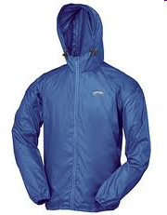
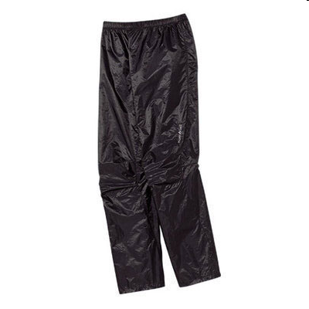
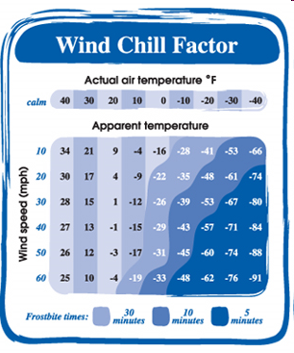
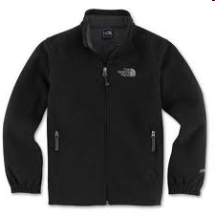

Slide 6
Evaporation
Heat transfer by phase change
Cooling process
Whee!
Examples
Cooling towers @ PSU
Sweat
Poly layers keep skin dry
Cotton = death
If you always lose the fastest…

Slide 7
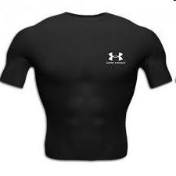
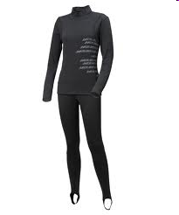
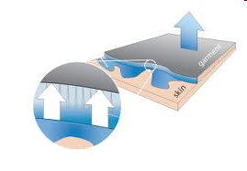

Slide 8
Radiation
Hot objects radiate photons (black body radiation)
Heating up a poker
Bonfire/barn fire/stoves
The sun
Frost
Silver lined blankets/bags reflect radiation back to you
Demo – check temperatures on radiation demo

Slide 9
