Slide 1
Phase change and latent heat
Contents:
Phases of matter
Changing phase
Latent heat
Graphs of phase change
Whiteboard
Graph whiteboards

Slide 2
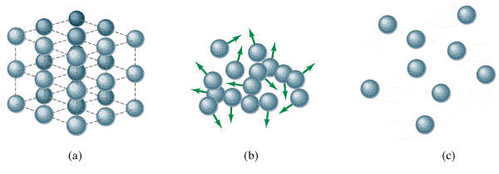
4 Phases of Matter
Solid
Crystalline/non crystalline
Liquid
Greased marbles
Gas
Ping pong balls
Plasma
Electrons no longer bound to particular nucleus
TOC

Slide 3
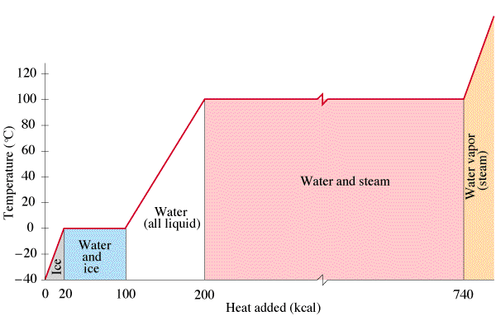
Phase changes and latent heat
KE
KE
KE
PE
PE
TOC

Slide 4
Melting or boiling a substance
Q = mL
Q - Heat (in J)
m - Mass (in kg)
L - Latent heat (in J kg⁻¹) of
fusion = melting
vaporization = boiling
Q -> Potential Energy
(Temperature does not rise)
TOC

Slide 5
Melting or boiling a substance
Q = mL
Some latent heats
(in J kg⁻¹) Fusion Vaporisation
H₂O 3.33 x 10⁵ 22.6 x 10⁵
Lead 0.25 x 10⁵ 8.7 x 10⁵
NH₃ 0.33 x 10⁵ 1.37 x 10⁵
Notice that these are all huge
Notice that vaporisation is more
TOC

Slide 6
Latent Heat
1 | 2 | 3 | 4
TOC

Slide 7
Dewey Cheatham melts 4.51 kg of lead. What heat is needed?
Some latent heats
(in J kg⁻¹) Fusion Vaporisation
H₂O 3.33 x 10⁵ 22.6 x 10⁵
Lead 0.25 x 10⁵ 8.7 x 10⁵
NH₃ 0.33 x 10⁵ 1.37 x 10⁵
Q = mL
Q = ??, m = 4.51 kg, L = .25 x 10⁵ J kg⁻¹
112,750 J = 1.1 x 10⁵ J
W
1.1 x 10⁵ J

Slide 8
Helen Highwater pumps 45 MJ (45 x 10⁶ J) of heat into some water at 100 ºC. How much boils away?
Some latent heats
(in J kg⁻¹) Fusion Vaporisation
H₂O 3.33 x 10⁵ 22.6 x 10⁵
Lead 0.25 x 10⁵ 8.7 x 10⁵
NH₃ 0.33 x 10⁵ 1.37 x 10⁵
Q = mL
Q = 45 x 10⁶ J, m = ??, L = 22.6 x 10⁵ J kg⁻¹
19.91 kg
W
20. kg

Slide 9
Aaron Alysis has a 1500. Watt heater. What time will it take him to melt 12.0 kg of ice, assuming all of the heat goes into the water at 0 ºC
Some latent heats
(in J kg⁻¹) Fusion Vaporisation
H₂O 3.33 x 10⁵ 22.6 x 10⁵
Lead 0.25 x 10⁵ 8.7 x 10⁵
NH₃ 0.33 x 10⁵ 1.37 x 10⁵
Q = mL, power = work/time (= heat/time)
Q = ??, m = 12.0 kg, L = 3.33 x 10⁵ Jºkg⁻¹
3,996,000 J, power = heat/time
heat = 3,996,000 J, power = 1500. J/s
W
2660 seconds

Slide 10
Eileen Dover takes 1.42 kg of ice ( c = 2100 J ºC⁻¹kg⁻¹) from -40.0 ºC to water ( c = 4186 J ºC⁻¹kg⁻¹) at 20.0 ºC. What TOTAL heat is needed?
Some latent heats
(in J kg⁻¹) Fusion Vaporisation
H₂O 3.33 x 10⁵ 22.6 x 10⁵
Q = mc_{ice}ΔT + mL + mc_{water}ΔT
711022.4 J
W
7.11 x 10⁵ J

