Slide 1
Specific heat
Contents:
Heating up a substance - specific heat
Whiteboards

Slide 2
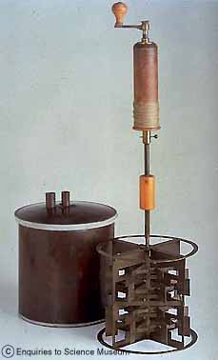
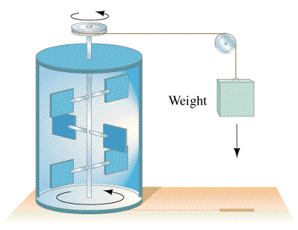
Joule’s Discovery
Falling mass heated water by stirring
Heat equivalent of work
1 Calorie = 4.186 J
TOC

Slide 3
Heating up a substance - Specific heat
Q = mcΔT
Q - Heat (in J)
m - Mass (in kg)
c - Specific Heat (in JºC⁻¹kg⁻¹)
ΔT - Change in temp. (ºC)
Q -> Kinetic Energy of molecules
(Temperature rises)
Some specific heats
(in JºC⁻¹kg⁻¹)
H₂O liquid 4186
H₂O ice 2100
H₂O steam 2010
Aluminum 900
Iron 450
More in table 14-1
(p 421)
TOC

Slide 4
Heating up a substance - Specific heat
Some specific heats
(in JºC⁻¹kg⁻¹) (in JºC⁻¹mol⁻¹)
Aluminum 900 24.4
Carbon 507 6.11
Copper 386 24.5
Lead 128 26.5
Silver 236 25.5
Tungsten 134 24.8
TOC

Slide 5
Specific Heat
1 | 2 | 3 | 4
TOC

Slide 6
A. Nicholas Cheep wants to calculate what heat is needed to raise 1.5 liters (1 liter = 1 kg) of water by 5.0 ºC. Can you help him? (c = 4186 J ºC⁻¹kg⁻¹)
Q = mcΔT
Q = ??, m = 1.5 kg, c = 4186 J ºC⁻¹kg⁻¹, ΔT = 5.0 ºC
W
31,000 J

Slide 7
Adella Kutessen notices what change in temperature if 512 g of iron absorbs 817 J of heat (c = 450. J ºC⁻¹kg⁻¹)
Q = mcΔT
Q = 817 J, m = 0.512 kg, c = 450. J ºC⁻¹kg⁻¹, ΔT = ??
W
3.55 ºC

Slide 8
Anita Break notices that a chunk of Aluminium absorbs 12,000 J of heat while raising its temperature a mere 3.45 ºC Of what mass is this chunk? (c = 900. J ºC⁻¹kg⁻¹)
Q = mcΔT
Q = 12,000 J, m = ??, c = 900. J ºC⁻¹kg⁻¹, ΔT = 3.45 ºC
W
3.9 kg

Slide 9
Anne Sodafone does an experiment where 5.412 kg of a mystery substance absorbs 12,510 J of heat while raising its temperature 2.19 ºC What is the specific heat?
Q = mcΔT
Q = 12,510 J, m = 5.412 kg, c = ??, ΔT = 2.19 ºC
W
1060 J ºC⁻¹kg⁻¹

