Slide 1
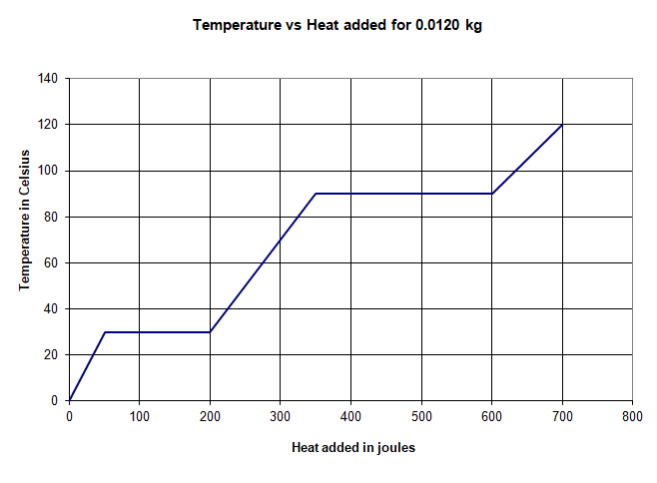
0.0120 kg of some substance starts at 0ºC as a solid.
Here is a graph of the temperature as heat is added
0. Label the solid, solid + liquid, liquid, liquid + gas, and gas regions
1. What is the melting and boiling temperature? (30 ºC, 90 ºC)
2. How much heat flows in to melt the substance? What is its latent heat of fusion? (150 J, 12,500 J/kg)
3. What is its latent heat of vaporisation? (20,833 J/kg)
4. How much heat does the solid phase absorb? What is the temperature change of the solid phase? What is the specific heat of the solid phase? (50 J, 30ºC, 139 J/kgºC)
5. What is the specific heat of the liquid phase? (208 J/kgºC)
6. What is the specific heat of the gas phase? (278 J/kgºC)

Slide 2
0.0120 kg of some substance starts at 0ºC as a solid.
Here is a graph of the temperature as heat is added
Q = ml (melting or boiling)
Q = mcΔT (When there is a ΔT)
0. Label the solid, solid + liquid, liquid, liquid + gas, and gas regions
1. What is the melting and boiling temperature?
2. How much heat flows in to melt the substance? What is its latent heat of fusion?
3. What is its latent heat of vaporisation?
4. How much heat does the solid phase absorb? What is the temperature change of the solid phase? What is the specific heat of the solid phase?
5. What is the specific heat of the liquid phase?
6. What is the specific heat of the gas phase?

