Slide 1
First law of Thermodynamics
Contents:
Basic Concept
Example
Whiteboards

Slide 2
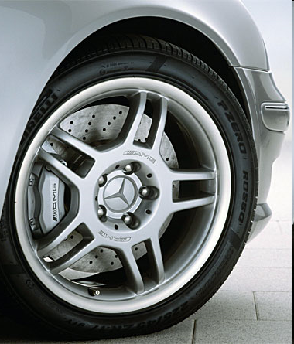
First law of Thermodynamics
1. Energy is conserved. (heat is also energy)
KE and PE can be turned to heat
Heat can be turned to KE and PE
Car brakes
Bike brakes on mountain roads
Hammers hitting nails
Demo - steel balls and paper
TOC

Slide 3
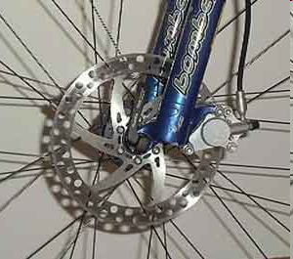
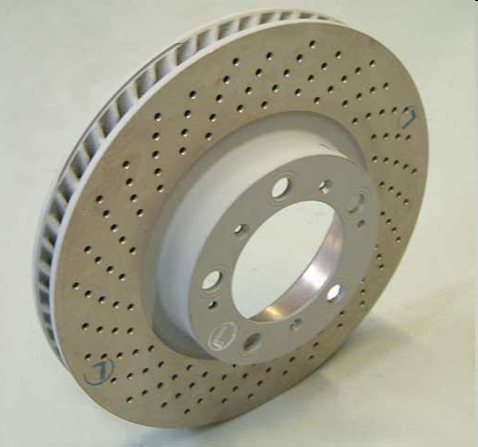
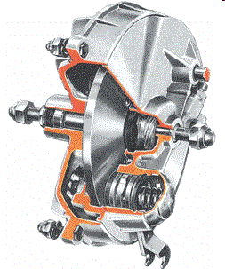

Slide 4
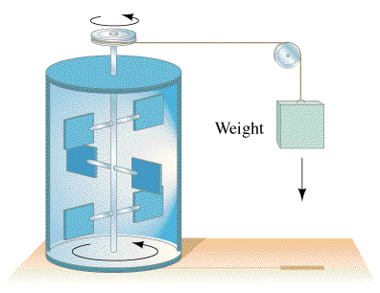
Example
Myron Wondergaim lets a
54.1 kg weight fall, turning a
stirrer in an insulated container
holding .872 kg of water
initially at 20.0 ºC. What
distance has the mass descended
at a constant speed when the
water reaches a temperature of 30.0 ºC?
c_{w}= 4186 J/kg/ºC
potential energy = Heat gained
mgh = m_{w}c_{w}ΔT_{w}
(54.1 kg) (9.8 N/kg)h = (.872 kg)(4186 J/kg/ºC)(10.0 ºC)
h = 68.7 m
TOC

Slide 5
First law problems
1 | 2
TOC

Slide 6
Hugo Idonuana drops a 4.5 kg bag of lead shot from a height of 32 m. What is the change in temperature of the shot assuming that all of the potential turns into heat absorbed by the shot?
(c_{Pb} = 130 JºC⁻¹kg⁻¹)
(Does the answer depend on the mass of the lead shot?)
Potential energy = Heat gained
mgh = m_{Pb}c_{Pb}ΔT_{Pb}
(4.5)(9.8)(32) = (4.5)(130) ΔT_{Pb}
ΔT_{Pb} = 2.4 ºC
W
2.4 ºC

Slide 7
Jenny Rator hits a 15 gram nail with a 2.5 kg hammer. What is the velocity of the hammer if the nail rises in temperature .55 ºC with each stroke of the hammer? (assume the nail absorbs all the heat evolved)
(c_{Fe} = 450 JºC⁻¹kg⁻¹)
Kinetic energy = Heat gained
¹/₂mv² = m_{Fe}c_{Fe}ΔT_{Fe}
¹/₂(2.5)v² = (.015)(450)(.55)
v = 1.7 m/s
W
1.7 m/s

