Slide 1
Kinetic Theory
Contents:
Concept 0
Temperature
Thermal Expansion (Qualitative)

Slide 2
Kinetic Theory 101
The higher the temperature, the faster the molecules
Temperature is proportional to average kinetic energy
Average(¹/₂mv²) = ³/₂kT - (not in data packet)
(( ))
(((
)))
( )
(
)
((
))
(
)
( )
(( ))
( )
( )
( )
( )
Hot = more E_{k}
Cold = less E_{k}
Demo - show molecular motion device
TOC

Slide 3
Temperature
Water
Boil
Freeze
Celsius
100 ºC
0 ºC
Fahren.
212 ºF
32 ºF
0 ºF
Kelvins
373.15 K
273.15 K
0 K
Not degrees K
What 0 ºF and 0 K mean
Formulas for conversion
Celsius: 30,20,10,0
TOC

Slide 4
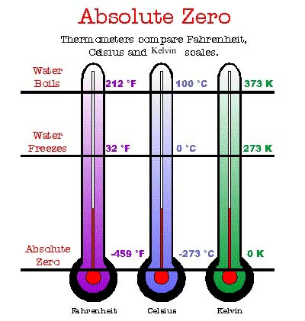

Slide 5
Temperature
1 | 2 | 3
TOC

Slide 6
What is 37 ºC in Kelvins?
Kelvins = 273.15 + 37 = 310.15 K = 310. K :-)
W
310. K

Slide 7
What is 77.35 K in ºC
273.15 K = 0 ºC
So it would be 77.35 - 273.15 = -195.80 ºC
(Boiling point of Liquid N₂)
W
-195.80 ºC

Slide 8
What is 128 ºC in Kelvins?
Kelvins = 273.15 + 128 = 401.15 K = 401 K :-)
W
401 K

Slide 9
What is 38 ºF in ºC
it’s 6 ºF above freezing
6*5/9 = 3.3 ºC
W
3.3 ºC

Slide 10
Thermal Expansion
Hotter is bigger
(( ))
(((
)))
( )
(
)
((
))
(
)
( )
(( ))
( )
( )
( )
( )
Hot = more E_{k}
Cold = less E_{k}
Demo - ball and hoop, bi-metal
TOC

Slide 11
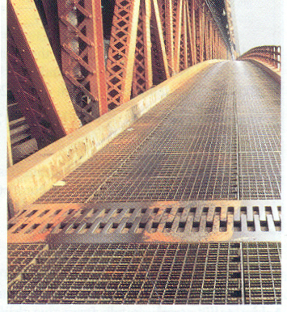
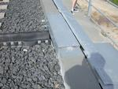
Railroad rails
Non-Pyrex glassware
Hiroshima exfoliation of stone buildings

