Slide 1
Hydrostatic Pressure
Contents:
How to calculate
Whiteboards

Slide 2
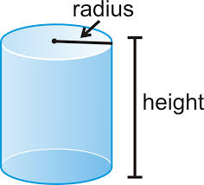
Pressure at some depth in a fluid:
P = Pressure (gauge) in Pa
ρ = Density in kg m⁻³
g = 9.81 N kg⁻¹
h = depth in m
Demo basin with holes/Same level tubes
Example – What is the gauge pressure 3800 m (12,500 ft) deep in the ocean where the wreck of the Titanic lies? Calculate it in Pa, PSI and atm. (ρ = 1.025x10³ kg m⁻³)
(3.8E7 Pa, 5.5E3 PSI, 380 atm (377.2 with no sf)) 10 m ≈ 1atm

Slide 3
In the data packet:
P = Absolute Pressure in Pa
P_{o} = Atmospheric pressure above fluid Pa
ρ_{f} = Density (of fluid?) in kg m⁻³
g = 9.81 N kg⁻¹
d = depth in m
Example – At what depth below fresh water is the absolute pressure 100. PSI? (P_{o} = 1.013x10⁵ Pa, ρ = 1.00x10³ kg m⁻³)
(59.9 m)

Slide 4
Hydrostatic Pressure
1 | 2 | 3

Slide 5
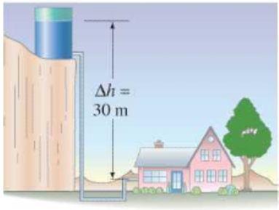
The water level in a water tower is 30. m above the point where a faucet is. What is the pressure in Pa and PSI? (P_{o} = 1.013x10⁵ Pa, ρ = 1.00x10³ kg m⁻³)
What is the gauge pressure in PSI?
solution
answer

Slide 6
question
solution
answer

Slide 7
question
solution
answer

