Slide 1
Pascal’s Principle
Contents:
How to calculate
Whiteboards

Slide 2
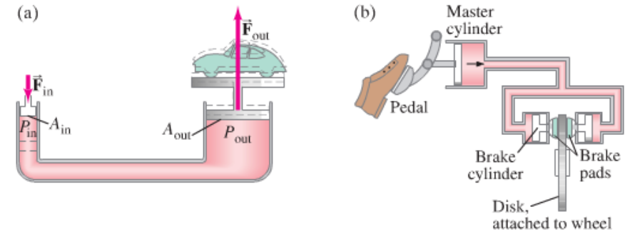
A confined fluid transmits external pressure:
Demo - hydraulic jack

Slide 3
Example – A hydraulic jack has an input piston with a diameter of 8.2 mm, and an output piston diameter of 95 mm. What force in pounds do you need to apply to lift a ton?
(1 ton is 2000 lbs)
(15 lbs)

Slide 4
Pascal’s Principle
1 | 2 | 3

Slide 5
question
solution
answer

Slide 6
question
solution
answer

