Slide 1
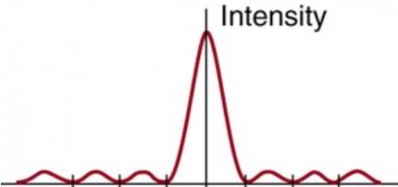
6. A single slit is illuminated by 460. nm light. The angular width of the central maximum is 1.20º. What is the width of the slit?
(0.0439 mm)

Slide 2
7. A single slit has a width of 0.0680 mm and is illuminated by 715 nm light. What is the angle between the center of the central maximum, and the second minimum on one side? (1.20º)

Slide 3
8. A single slit has width of 0.0287 mm. There is an angle of 2.15º separating the center of the first maximum on one side with the center of the first maximum on the other side. What is the wavelength of light? (359 nm)

Slide 4
9. A single slit is illuminated by 656 nm light, and there is a 3.10º angle between the second maximum on one side, and the center of the central maximum. What is the width of the slit? (0.0303 mm)

Slide 5
10. A single slit has a width of 0.0243 mm, and there is a angle of 2.61º between the first maximum on one side, and the third minimum on the same side. What is the wavelength of the light? (738 nm)

Slide 6
14. A single slit is illuminated by 524 nm light. A screen 4.20 m away has a central maximum pattern where the first minimum on one side is separated from the second by a distance of 1.26 cm. What is the width of the slit? (1.75x10⁻⁴ m)

Slide 7
15. A single slit has a width of 0.152 mm and is illuminated by 740 nm light. The interference pattern is projected on a screen that is 2.57 m away. What is the distance on the screen from the center of the central maximum to the center of the second maximum on one side? (3.13 cm)

Slide 8
19. A diffraction grating has 2083 lines/cm. It is illuminated by a monochromatic light beam. There is an angular separation of 8.13º between the central maximum and the first order fringe. What is the wavelength of light? (679 nm)

Slide 9
20. A diffraction grating is illuminated by a 596 nm light. There is an angle of 38.2º between the central maximum and the third order fringe on one side. How many lines per cm does the grating have? (3459 lines/cm)

Slide 10
question

