Slide 1
0. Sound travels at 1498 m/s in water, and 343 m/s in the air. An explosion occurs on the surface of the water 1250 m away. What time does it take the sound to reach you in the air? What time does it take the sound to reach you in the water? What amount of time separates the arrival of the sound in the water and in the air?
(Air: 3.644 s, Water: 0.834 s, Difference: 2.81 s)

Slide 4
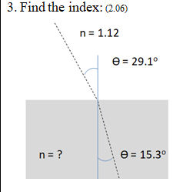

Slide 5
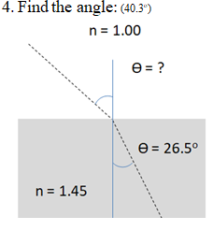

Slide 6
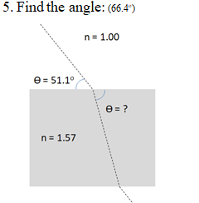

Slide 7
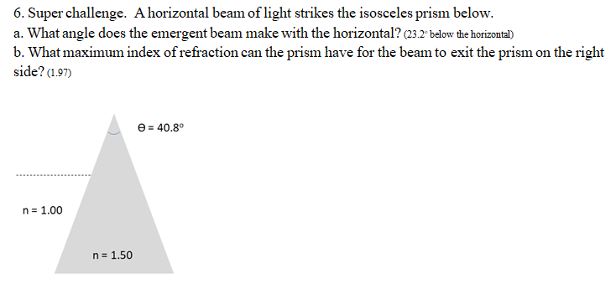

Slide 8
n = 1.12
ϴ = 29.1º
n = ?
ϴ = 15.3º

Slide 9
n = 1.00
ϴ = ?
ϴ = 26.5º
n = 1.45

Slide 10
n = 1.00
ϴ = 51.1º
ϴ = ?
n = 1.57

Slide 11
ϴ = 40.8º
n = 1.00
n = 1.50

