Slide 1
diffraction

Slide 2
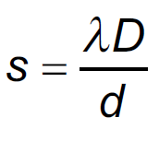
1. A parallel beam of light from a laser with a wavelength of 632.8 nm falls on two very narrow slits 0.0320 mm apart.
a. The bright fringes are 6.7 cm apart on a screen some distance away. What is the distance to the screen? (3.39 m)
b. What angle separates the central fringe, and the third order fringe? What distance is this on the screen? (3.40º, 20.1 cm)

Slide 3
2. Two narrow slits are separated by 0.0895 mm are illuminated by monochromatic light. The fringes on the screen 2.10 m away are 9.72 mm apart.
a. What is the wavelength of light? (414 nm)
b. What angle separates the central bright spot and the 4th order fringe? What distance is this on the screen? ( 1.06º, 3.89 cm)

Slide 4
3. Two slits make an interference pattern with 550. nm light on a screen that is 4.50 m away. The distance separating the third order fringe on the left from the third order on the right is 5.14 cm. What is the distance separating the slits? (2.89x10⁻⁴ m or 0.289 mm)

Slide 5
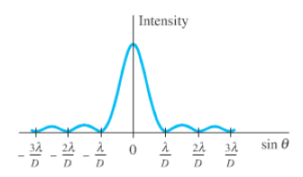
4. If 410. nm light falls on a slit 0.0320 mm wide,
a. What is the full angular width of the central diffraction peak? (0.0256 rad or 1.47º)
b. What is its width on a screen that is 3.60 m away? (9.22 cm)
c. What distance separates the central maximum from the next maximum on a screen 7.10 m away? (13.6 cm)

Slide 6
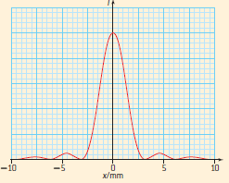
5. Light from a helium–neon laser passes through a narrow slit and is incident on a screen 5.20 m from the slit. The graph to the right shows the variation with distance x along the screen of intensity I of the light on the screen. The wavelength of the laser is 632.8 nm.
a. Determine the width of the slit. (1.01 mm)
b. What two changes would happen to the pattern if we were to increase this width? (central maximum: brighter, narrower)
b. What would happen to the pattern if we were to increase the wavelength of the light? (central maximum: broader, other maxima more spread out)

Slide 7
6. A diffraction grating produces a third order spectral line at 23.0º for 815 nm light.
a. What is the distance between the slits or lines? (6.26x10⁻⁶ m)
b. How many lines are there per cm? (1598)

Slide 8
7. A diffraction grating has 640. lines per millimeter. It is illuminated by monochromatic light. There is an angle of 17.2º between the central maximum and the second order maximum on one side.
a. What is the distance between the slits or lines? (1.56x10⁻⁶ m)
b. What is the wavelength of light being used? (231 nm)

Slide 9
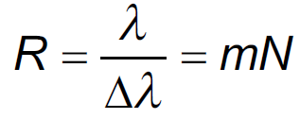
8. A diffraction grating is used to resolve two lines in a spectrum in the first order. The two lines have wavelengths of 632.185 nm and 631.341 nm. Determine the minimum number of slits in the grating that will enable the two lines to be resolved. (749 slits)

Slide 10
9. A 3.80 mm-wide beam of 432.7 nm light illuminates 1,112 slits in a diffraction grating.
a. What is the smallest difference in wavelength from this wavelength that the grating can resolve in the second order? (0.195 nm)
b. How many slits per cm does this grating have? (2930 lines per cm)

