Slide 1
1. Two speakers 4.00 m apart are in phase at 877.24 Hz. If I am 1.450 m from one speaker, and 3.210 m from the other, how many wavelengths difference is the distance, and is it constructive (loud) or destructive (quiet) interference? (4.5 wavelengths – destructive or quiet)

Slide 3
1. Two speakers 4.10 m apart are in phase at 512 Hz. If I am 4.00 m from one speaker, and 6.68 m from the other, what is the wavelength, and how many wavelengths difference is the distance, and is it constructive (loud) or destructive (quiet) interference?
(λ= 0.670 m, 4 λ, Constructive)

Slide 4
2. Two speakers 4.50 m apart are in phase at 256. Hz. If I am 3.00 m from one speaker, and 6.35 m from the other, what is the wavelength, and how many wavelengths difference is the distance, and is it constructive (loud) or destructive (quiet) interference?
(λ= 1.34 m, 2.5 λ, Destructive)

Slide 5
3. Two speakers 5.00 m apart are in phase at 1024. Hz. If I am 8.42 m from one speaker, and 9.59 m from the other, what is the wavelength, and how many wavelengths difference is the distance, and is it constructive (loud) or destructive (quiet) interference?
(λ= 0.335 m, 2.5 λ, Destructive)

Slide 8
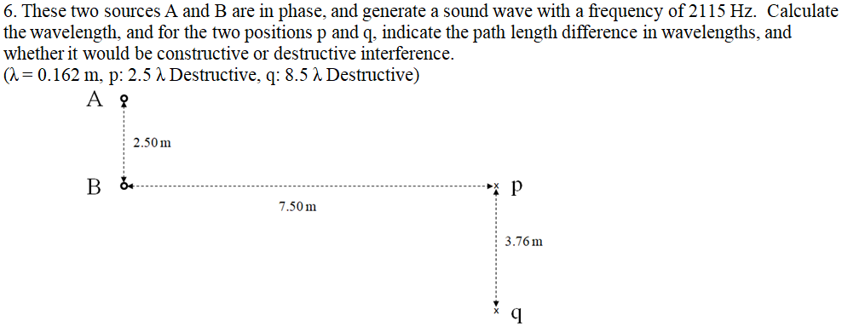

Slide 10
x
p
A
3.7 m
1.2 m
10.0 m
1.2 m
B
2.4 m
q
x

Slide 11
x
p
A
3.78 m
3.00 m
B
x
q
8.00 m

Slide 12
A
2.50 m
B
x
p
7.50 m
3.76 m
x
q

