Slide 1
FA 11.0 and 11.0 problems

Slide 2
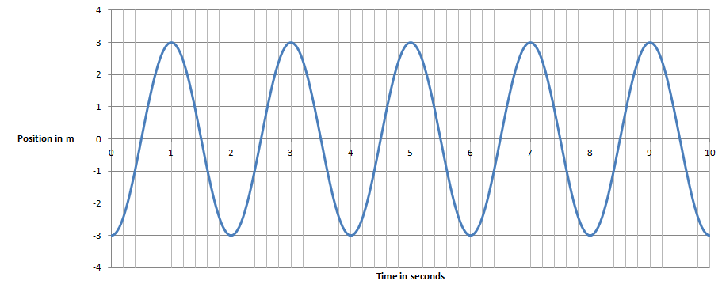
Given this graph of position vs. time for a SHO, determine:
1. T = x_{o} = v_{o} =
2. Write an equation for its position:
3. Write an equation for its velocity: (EC - write one for its acceleration)

Slide 3
4. At 4.2 seconds what is its position, velocity and acceleration?

Slide 4
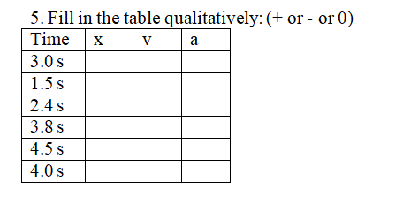

Slide 9
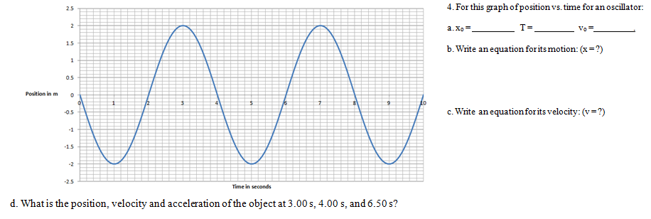

Slide 14
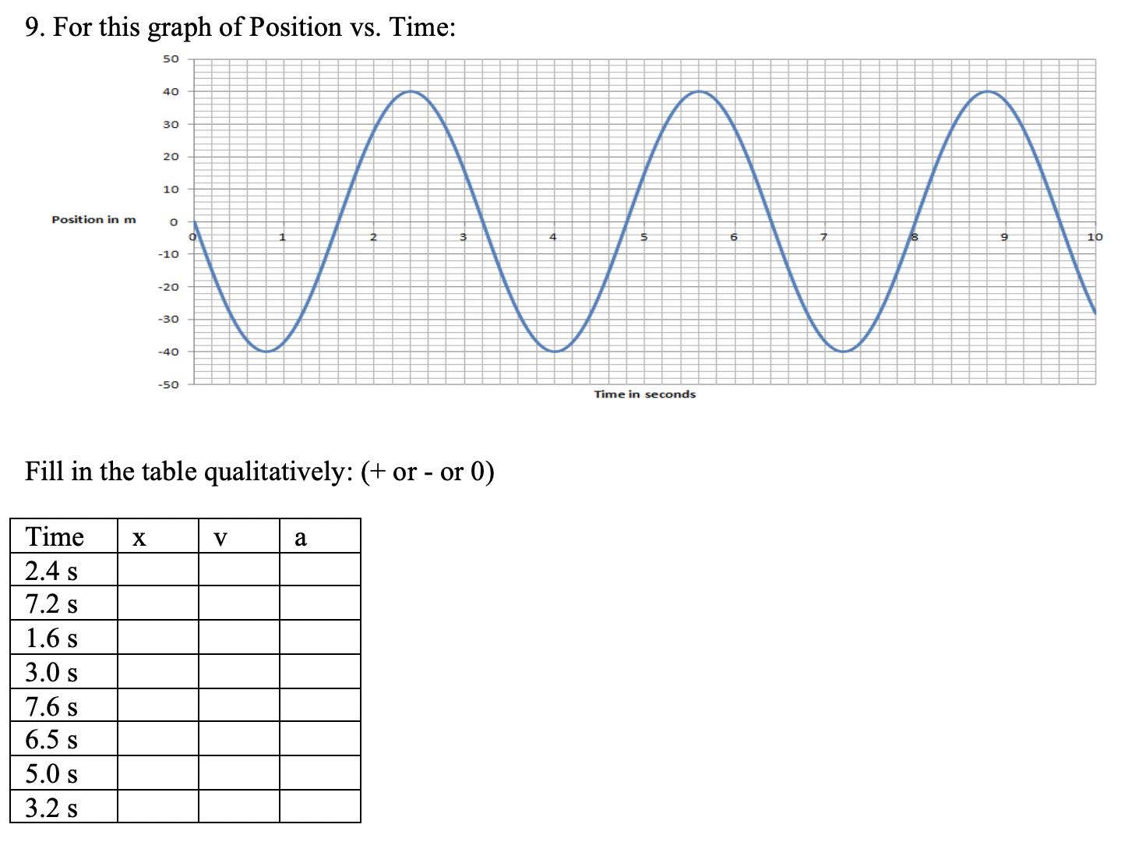

Slide 15
