Slide 1
Sound 101
Sound is longitudinal waves in matter:
We can hear
20 Hz - 20,000 Hz (demo test tone generator)
Most sound is more than one frequency (demo fft)
Show harmonics with guitar

Slide 2
Sound 101
Speed of sound in air at sea level:
v = (331 + 0.60T) m/s, T = temperature in ºC
Speeds of sound at 20 ºC and 1 ATM:
Air 343 m/s
Helium 1005 m/s
Water 1440 m/s
Steel 5000 m/s
Sound underwater - Leonard Natatorium
Sound in bones
Demo -The finger bells

Slide 3
The Speed of sound increases with temperature:
Speed of sound in air at sea level:
v = (331 + 0.60T) m/s, T = temperature in ºC
Example 1 – What is the speed of sound at 20 ºC? 42 ºC?
343 m/s, 356 m/s

Slide 4
Speed of sound
1 | 2 | 3 | 4

Slide 5
What is the speed of sound in air at 80 ºC?
v = (331 + .60T) m/s
v = 331 + .60(80) = 379 m/s
379 m/s

Slide 6
At what temperature in Celsius is the speed of sound 318 m/s?
v = (331 + .60T) m/s
318 = 331 + .60T
T = -21.7 ºC
-21.7 ºC

Slide 7
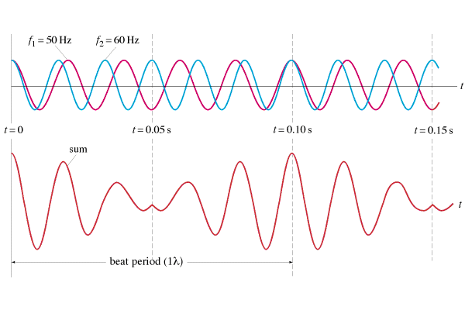
Beats
Two different pitches played together interfere:
f_{beat} = |f₁ - f₂|
Demo - pennywhistle, big pipes on burners

Slide 8
Examples
f_{beat} = |f₁ - f₂|
1. I play a pitch of 256 Hz (C) on my Pennywhistle, and you play a pitch of 384 Hz (G) on your whistle. What is the beat frequency? (128 Hz)
2. If I am playing a pitch of 384 Hz, and I hear a beat frequency of 10.0 Hz, what are the possible other frequencies that are playing?
(394 Hz and 374 Hz)

Slide 9
Beats
1 | 2

Slide 10
What beats do you hear if you play an e 640 Hz with a c 1024 Hz?
384 Hz, G in octave below the E

Slide 11
If you are playing an A 440 Hz, and you hear a beat frequency of 20 Hz, what are the other possible frequencies that could be playing?
460 Hz or 420 Hz

Slide 12
The concertmaster is playing an A 440.0 Hz. Another violin hears a beat every 0.20 seconds. What frequency are they playing?
445.0 Hz or 435.0 Hz

