Slide 1
Two Source Interference Patterns
Contents:
Superposition principle
Basic Concept
Two Source patterns
Whiteboards

Slide 2
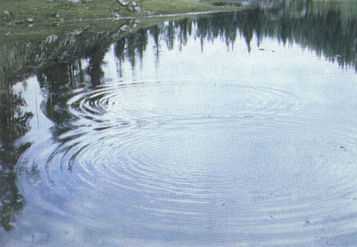
Principle of superposition
Overlapping waves add together
Examples:
People talking at the same time
Shining a flashlight across the room
Ripples on a pond overlapping:

Slide 3
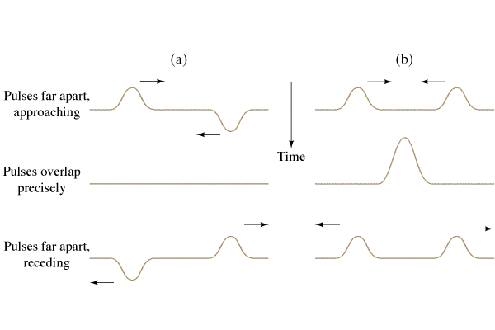
Principle of superposition
Overlapping waves add together
Destructive interference
Constructive interference
superposition demonstration

Slide 5
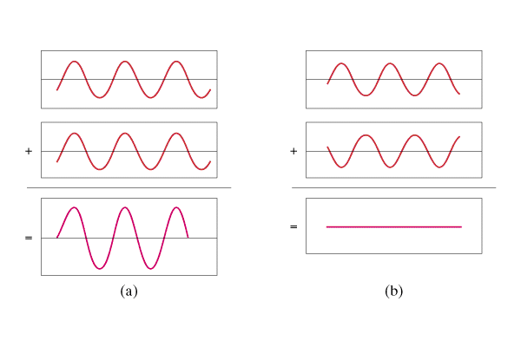
Interference:
Superposition - Overlapping waves add.
Constructive interference = crest meets crest
Destructive interference = crest meets trough
Constructive
Destructive

Slide 6
λ
A
B
If the difference in distance from the sources is an integer number of wavelengths, you get constructive interference

Slide 7
λ
A
B
If the difference in distance from the sources is an integer number of wavelengths, you get constructive interference

Slide 8
λ
A
B
If the difference in distance from the sources is an integer number of wavelengths, you get constructive interference
Difference is:
0 λ, 1 λ, 2 λ, 3 λ…

Slide 9
λ
A
B
If the difference in distance from the sources has a remainder of a half wavelength, you get destructive interference:

Slide 10
λ
A
B
If the difference in distance from the sources has a remainder of a half wavelength, you get destructive interference:

Slide 11
λ
A
B
If the difference in distance from the sources has a remainder of a half wavelength, you get destructive interference:
Difference
.5 λ, 1.5 λ, 2.5 λ, 3.5 λ…

Slide 12
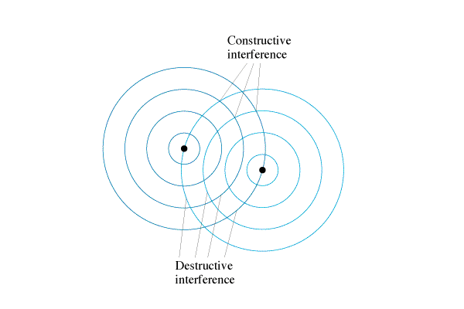
Basic Concept
Two Source Pattern
Constructive:
Crest meets crest
Trough meets trough
Destructive:
Crest meets trough
Demo speakers
Demo Laser Slits
PHET

Slide 13
Young’s Double Slit Experiment
Monochromatic, coherent light
Light spreads out from slits
Screen has sum of two sources
Interference pattern on screen
PHET

Slide 14
Interference
Sources
L₁
L₂
When the difference in distance (L₁- L₂) is an
integer number of wavelengths (0, 1, 2, 3…) = Constructive
remainder of a half (¹/₂, 1 ¹/₂, 2 ¹/₂, …) = Destructive

Slide 15
To figure out two source problems:
Calculate the λ
Find the difference in distance
Find out how many λ it is
Decide:
__.0 = constructive
__.5 = destructive
__.1 = mostly constructive
__.25 = ???

Slide 16
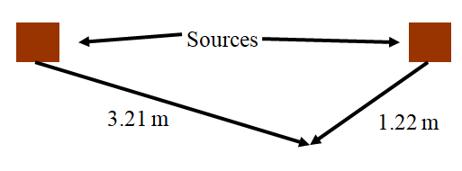
In air where the speed of sound is 350 m/s, two loudspeakers produce a frequency of 700. Hz.
a) what is the wavelength of the sound?
b) if we are 3.21 m from the left speaker, and 1.22 m from the right speaker, is it loud or soft?
c) if we are 4.65 m from the left, and 5.40 m from the right, is it loud or soft?
3.98 λ – loud, 1.50 λ - soft

Slide 17
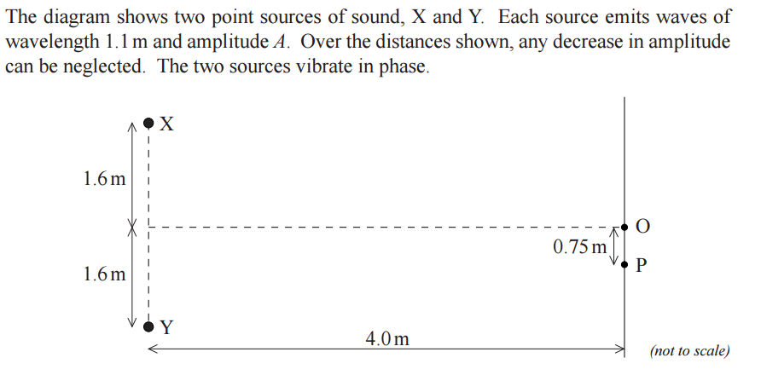
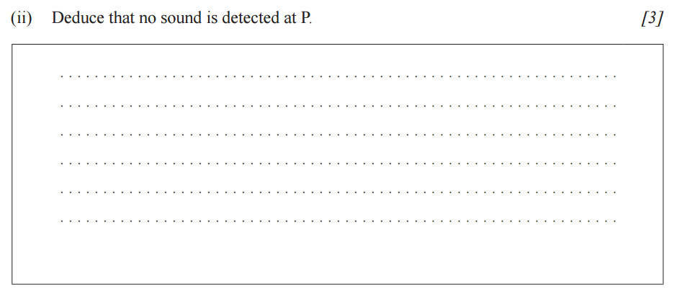

Slide 18
Whiteboards
1 | 2 | 3 | 4 | 5 | 6 | 7

Slide 19
Two speakers 3.0 m apart are making sound with a wavelength of 48.0 cm.
A. What is the frequency of this sound if v = 343 m/s?
715 Hz

Slide 20
Two speakers 3.0 m apart are making sound with a wavelength of 48.0 cm.
B. If I am 2.12 m from one speaker, and 3.80 m from the other, is it loud, or quiet, and how many wavelengths difference in distance is there?
3.5 wavelengths, destructive

Slide 21
Two speakers 3.0 m apart are making sound with a wavelength of 48.0 cm.
C. If I am 5.17 m from one speaker, and 8.05 m from the other, is it loud, or quiet, and how many wavelengths difference in distance is there?
6.0 wavelengths, constructive

