Slide 1
12 C1 and D1 - Intensity

Slide 2
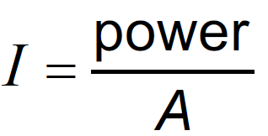
Concept 0: The definition of intensity:
Intensity (I) is the amount of power delivered per unit area.
I is in Watts per square meter (W/m²) or W m⁻²
I – Intensity in W m⁻²
power – power in Watts
A – Area in m²
(8.2 in the data packet)

Slide 3
I – Intensity in W m⁻²
power – power in Watts
A – Area in m²
(8.2 in the data packet)
Example: If the solar constant is 1360 W m⁻², what is the power incident on a solar panel that measures 1.98 m x 0.990 m and is facing directly into the sun? If the cells are 22.8% efficient, how much power do they generate? (2670 W, 608 W)

Slide 4
A sunlamp projects 45.0 Watts of power onto a piece of metal that measures 34.0 cm x 67.0 cm. What is the intensity of the light?
198 Wm⁻²

Slide 5
On a winter day in Oregon, the solar flux is 365 Wm-2. What is the total power incident on a roof that measures 12.5 m by 45.5 m and is angled cleverly so that it is perpendicular to the sun’s rays!!?
208 kW

Slide 6
You are designing a solar array for your house. You want to generate 5000. W of electricity on a sunny 980. W m⁻² day, but since your solar panels are only 22.8% efficient, you will need to capture 21,930 Watts of solar flux. What area is required to capture this amount of solar flux?
22.4 m²

Slide 7
Concept 1: The inverse square law:
Intensity is proportional to the inverse of the square of the distance we are to a source:
I – Intensity in W m⁻²
x – the distance from the source
(4.3 in the data packet)

Slide 8
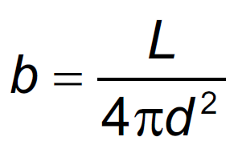
C1: Concept 1 – Apparent Brightness (The real formula in D.1)
Apparent Brightness
b = The apparent brightness in W/m²
L = The star’s Luminosity (in Watts) (power)
d = The distance to the star
L is spread out over a sphere..

Slide 9
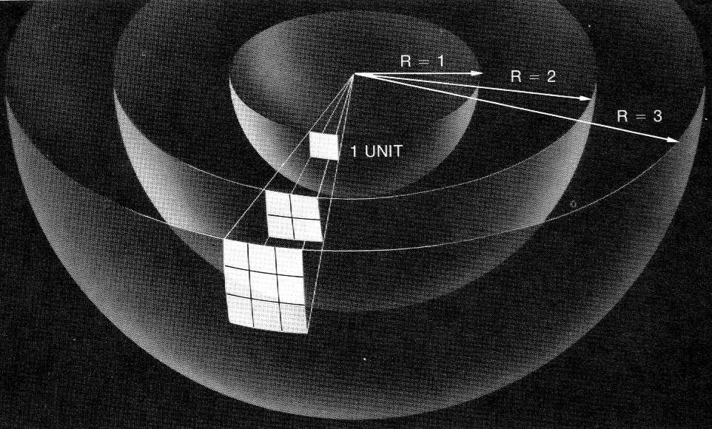
Apparent Brightness
The inverse square relationship
From Jay Pasachoff’s Contemporary Astronomy

Slide 10
I – Intensity in W m⁻²
x – the distance from the source
(4.3 in the data packet)
Example: If we are 204 cm from a source our intensity is
12.0 W m⁻². What would be our intensity if we were to move to 68.0 cm from the same source? (108 W m⁻²)

Slide 11
A sound source that is 4.50 m from us is hitting us with 3.40 mW m⁻² of power. What is the intensity if we were 6.70 m from it?
1.53 mW m⁻²

Slide 12
The intensity from a bright light is 260. W m⁻² when we are 3.85 m from it. At what distance would it be 450. W m⁻²?
2.93 m

Slide 13
What distance from a 60.0 W light source is the intensity
12.0 mW m⁻²?
19.9 m

Slide 14
D1: Concept 2: The relationship between Amplitude and Intensity:
Intensity is proportional to the square of the Amplitude
I – Intensity in W m⁻²
A – the amplitude of the wave
(4.3 in the data packet)
Example: The intensity due to one of a double slit arrangement is I_{o}. What is the intensity of the central maximum of the interference pattern when both slits are allowed to constructively interfere? (4I_{o})

Slide 15
Three narrow slits close together are illuminated by light. The intensity at the center of the three on a distant screen is 23.8 μW m⁻². due to the light from one of the slits. What is the intensity if all three constructively interfere at the center?
2.14x10⁻⁴ W m⁻²

Slide 16
A number of narrow slits close together are illuminated by light. When only one of the slits illuminates the screen, the central bright spot has an intensity of I_{o}. When all of the slits illuminate the screen, the intensity is 25I_{o} in the center.. How many slits are there?
5

Slide 17
Light from a heat lamp has an intensity of 467 W m⁻². If we were to double the amplitude of the light wave, what would be its intensity?
1868 W m⁻²

