Slide 1
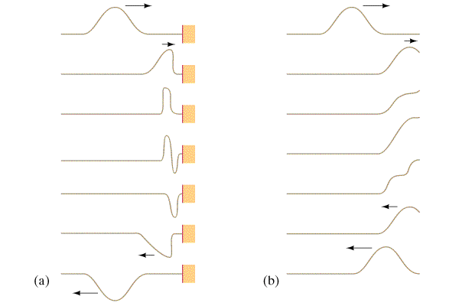
Why Reflections Occur
Reflections occur at any abrupt change in medium
Demo wave device - Fixed, Free, change

Slide 2
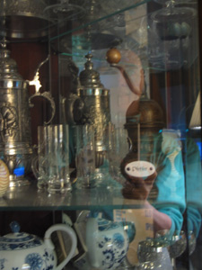
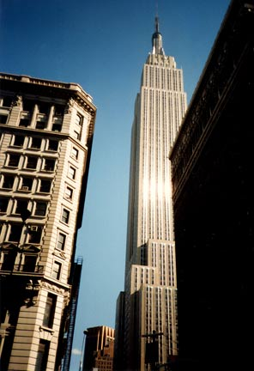
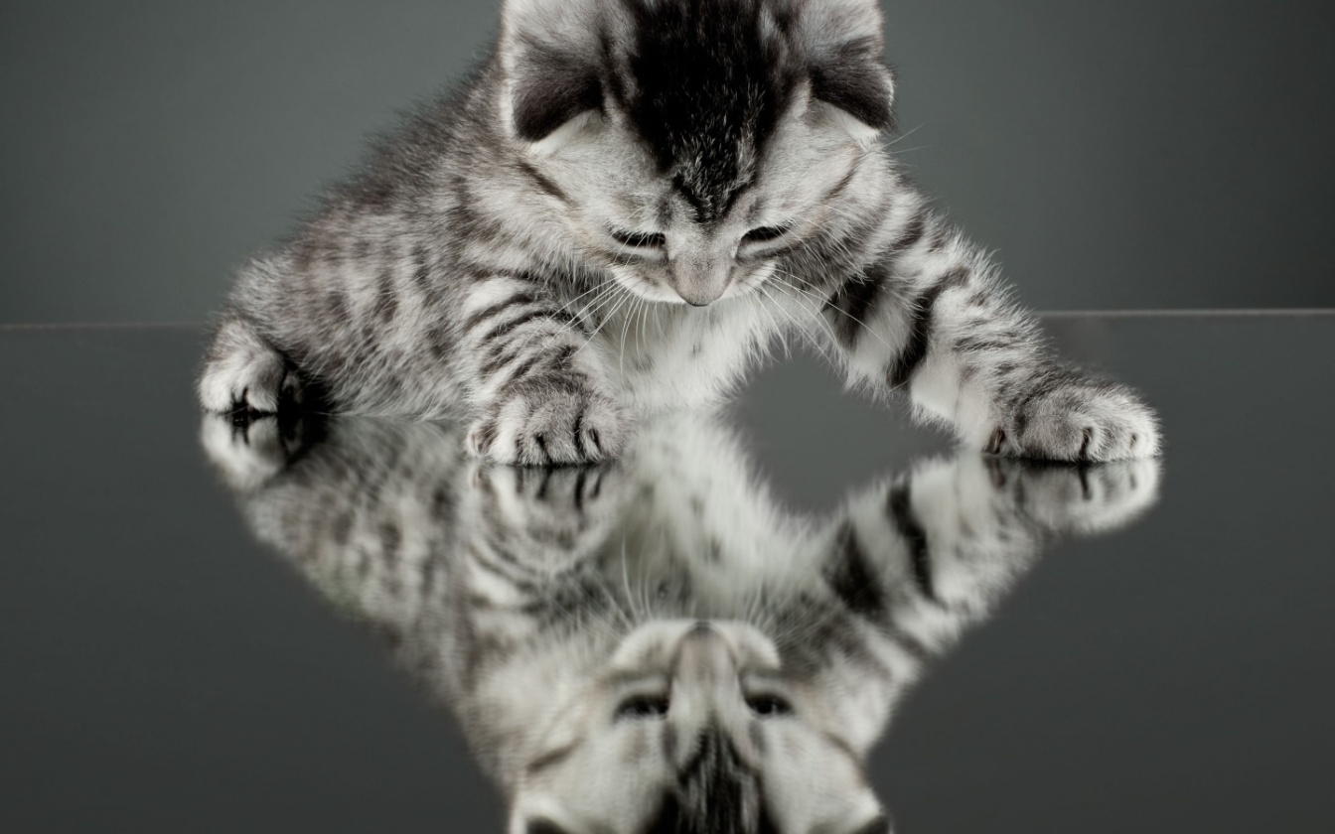
Why Reflections Occur
Reflections occur at any abrupt change in medium
Light Reflecting

Slide 3
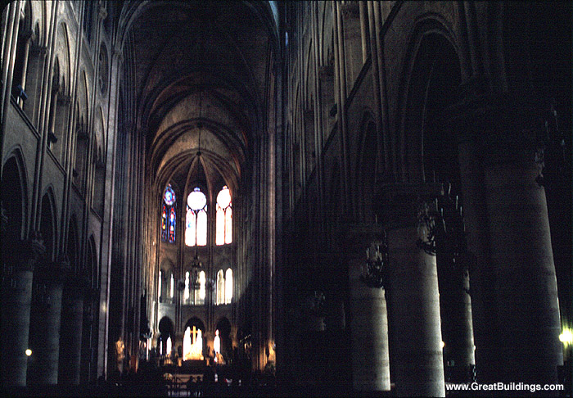
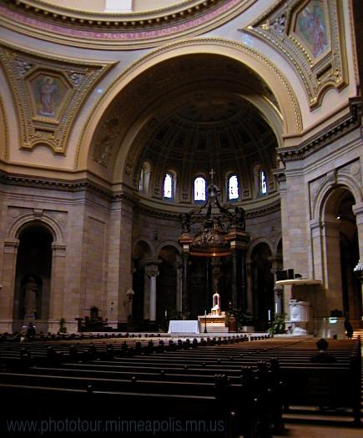
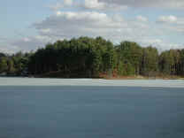
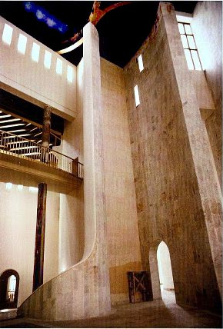
Why Reflections Occur
Reflections occur at any abrupt change in medium
Sound Reflecting
Notes:
St. Paul Cathedral, NotreDame cathedral

Slide 4
Why Reflections Occur
Reflections occur at any abrupt change in medium
More examples:
Waves off islands - Polynesian navigators
Long Distance telephone calls:
Your
phone
Their
phone
US Phone system
Cable or satellite
French phone system

Slide 5
Preventing reflections
Reflections occur at any abrupt change in medium
2 ways to prevent reflection:
Make there be no change in medium
Make the change less abrupt (i.e. gradual)
8
ohms
8
ohms
4
ohms
4
ohms
Your Stereo
Impedance
Transformer
Your Speaker

Slide 6
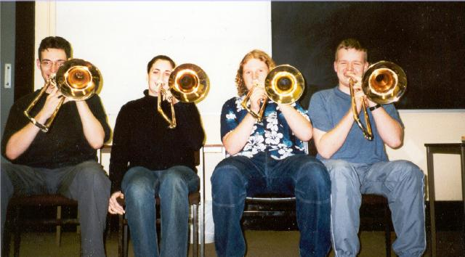
Preventing reflections
Reflections occur at any abrupt change in medium
2 ways to prevent reflection:
Make there be no change in medium
Make the change less abrupt (i.e. gradual)
More examples: -
Wave device demo
Coatings on telescope lenses
Acoustic impedance transformer (demo)
Bells on horns

Slide 7
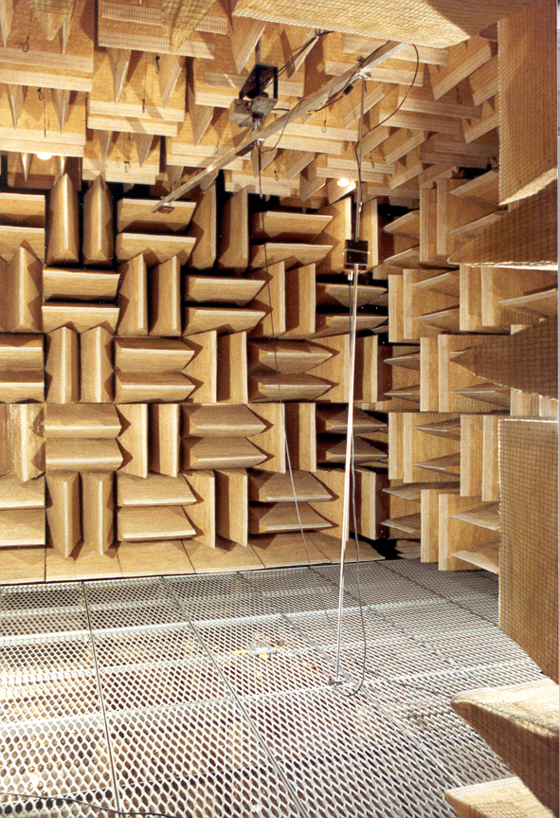
An anechoic room
Wave energy is dissipated
Note lack of reflective surfaces
Voice of tour guide

Slide 8
Types of reflections:
Fixed ends invert: (demo)
Free ends do not: (demo)

Slide 9
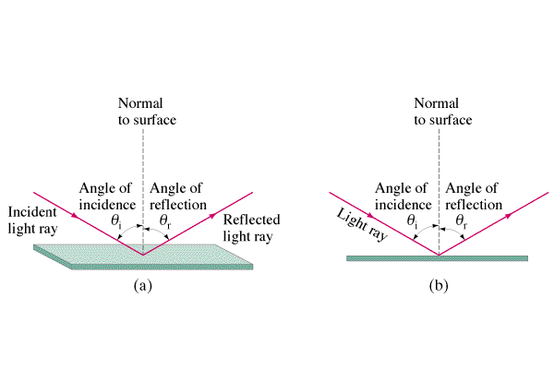
Angle of incidence = angle of reflection:
Note unusual measure of angle
Right angle corners
(prisms and Mt. St. Helens center)
Demo - laser/physics grooming mirror/Wash. Sq. Mall/sound in corners

Slide 10
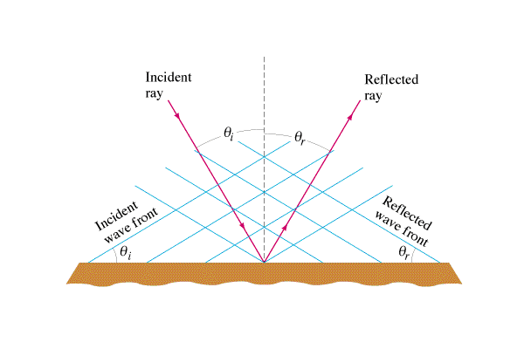
Angle of incidence = angle of reflection:

Slide 11
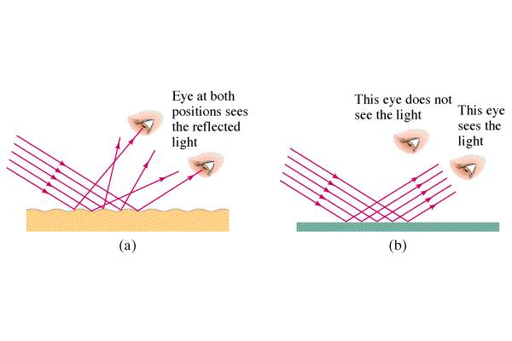
Smooth surfaces vs. rough
Every object reflects some light
Not always a mirror

