Slide 1
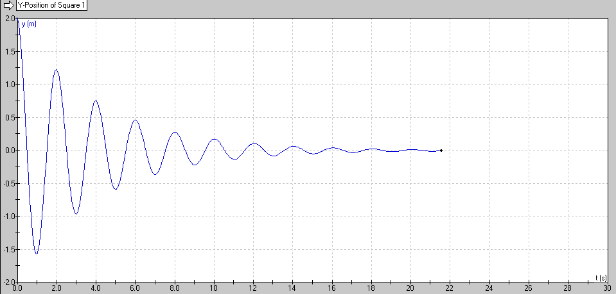
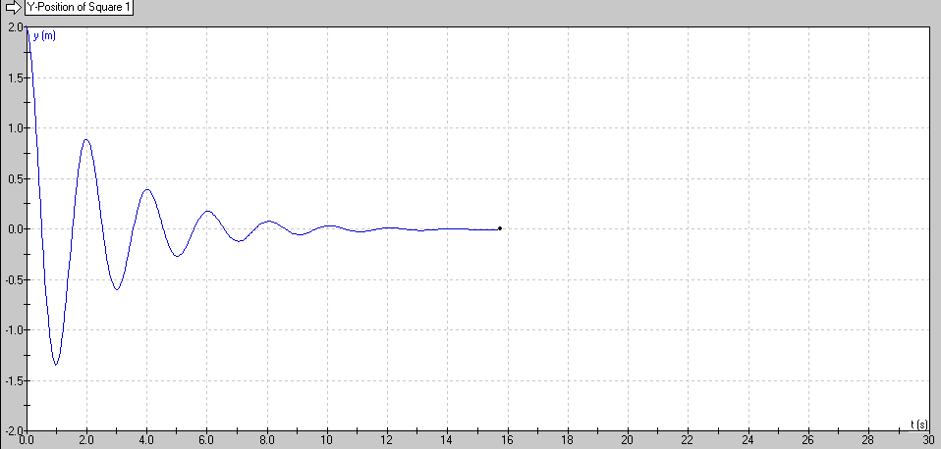
Resonance – Concept 2 – Q Factor
Q = 10
Q = 5
(Quality Factor)
Arbitrary engineering number
Roughly how many cycles it will go before it stops
Big Q = low damping

Slide 2
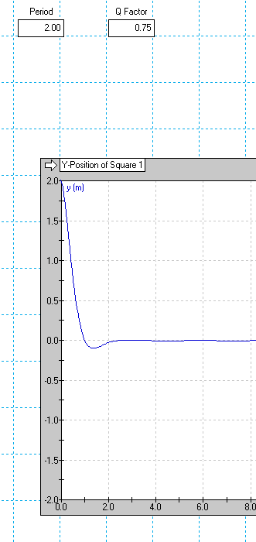
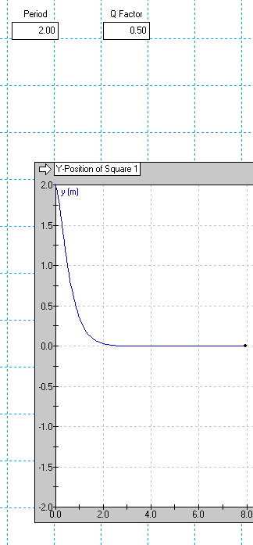
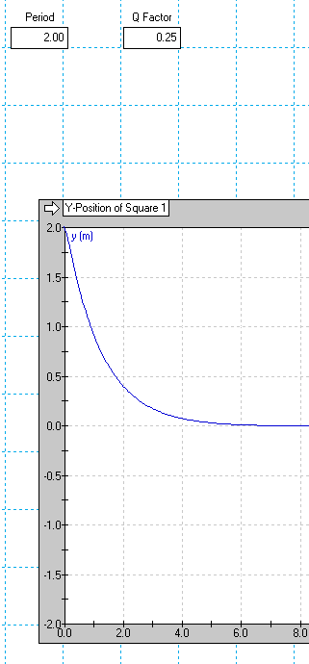
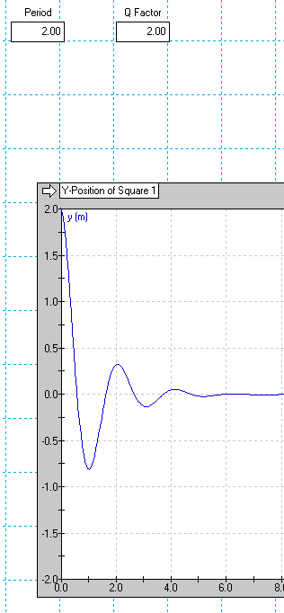
Critical Damping (Q = 0.5)
Shortest time, doesn’t overshoot, just over a cycle

Slide 3
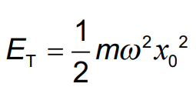
Calculations:
9.8

Slide 4
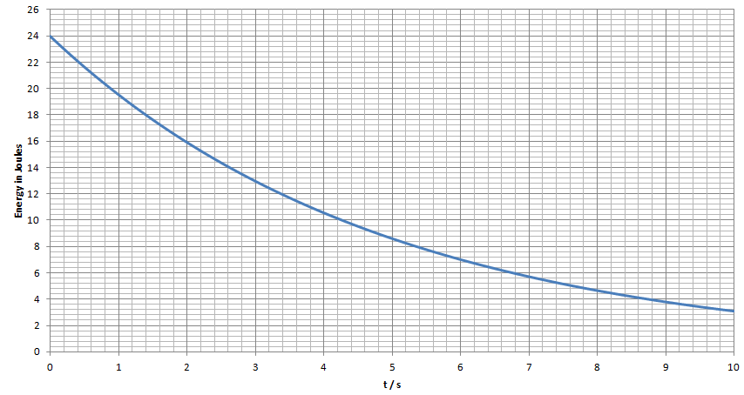
This is a graph of the energy in an oscillator with a period of 2.0 seconds. What is its Q factor? (19)

Slide 5
An oscillator has an initial amplitude of 18.0 cm, a mass of 0.105 kg, and a frequency of 5.20 Hz What is its initial stored energy? If it loses power initially at a rate of 135 mW, what is its Q value? (1.82 J, 439)

