Slide 1
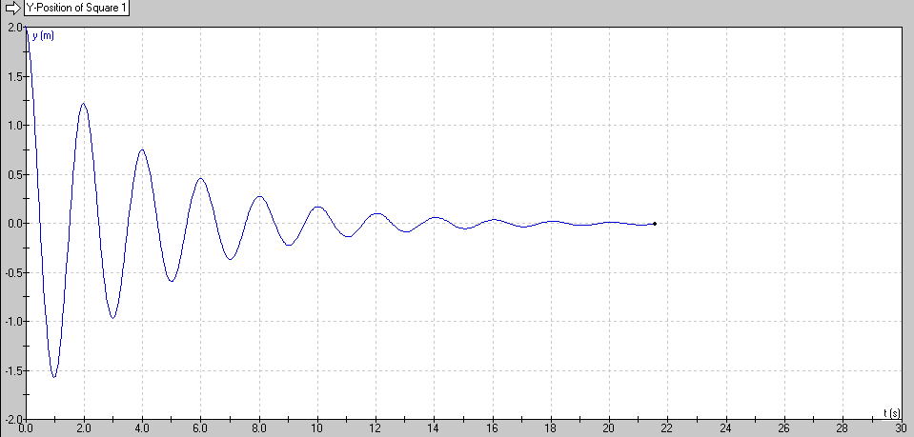
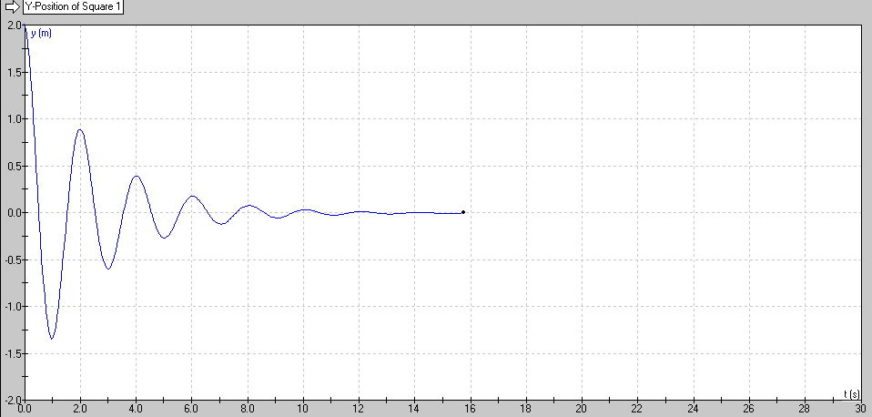
Resonance – Concept 2 – Q Factor
Q = 10
Q = 5
(Quality Factor)
Arbitrary engineering number
Roughly how many cycles it will go before it stops

Slide 2
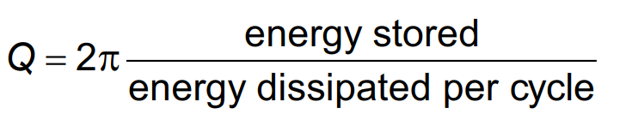
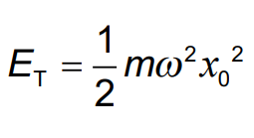
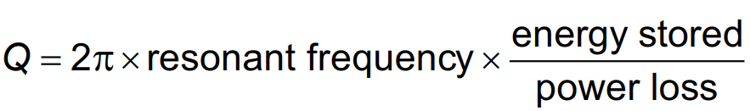
Calculations:

