Slide 1
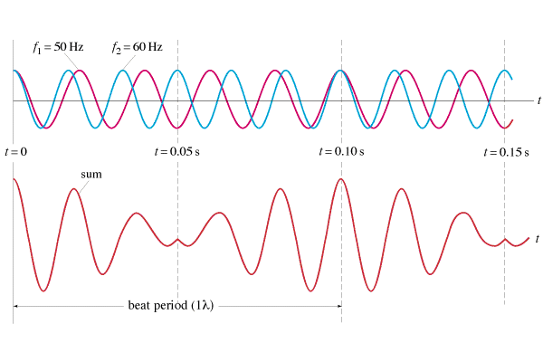
Beats
Two different pitches played together interfere:
f_{beat} = |f₁ - f₂|
Demo - pennywhistle, big pipes on burners

Slide 2
Music 101
Most instruments use standing waves
String and wind instruments follow overtone series:
A₅ 880 Hz
Octave = 2 x frequency
G₅ 770 Hz
E₅ 660 Hz
C#₅ 550 Hz
A₄ 440 Hz
E₄ 330 Hz
A₃ 220 Hz
A₂ 110 Hz
Play Harmonics
Harmony - Beats are consonant
Show lissajous

