Slide 1
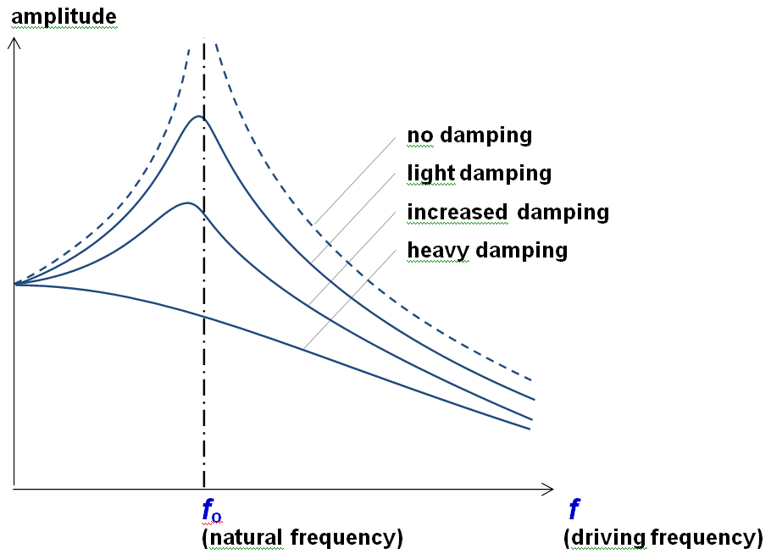
Resonance – Concept 0
x = x_{o}sin(ωt)
ω_{o} =
When ω = ω_{o}, = resonance
(Amplitude gets big)
Damping:
Lower peak
Smaller ω_{o} (Peak shifts left)
Broader peak
Extremes the same

Slide 2
