Slide 1
Diffraction and Resolution
Contents:
Diffraction
Resolution

Slide 2
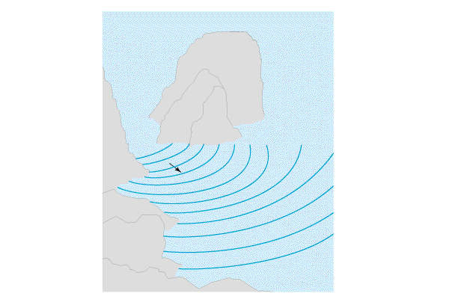
Diffraction - Waves bending to fill in shadows
TOC

Slide 3
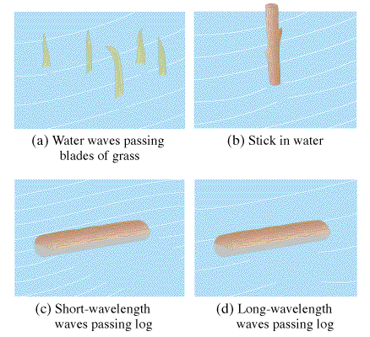
Diffraction - Waves bending to fill in shadows
Large λ diffract more
Small λ diffract less
Demo - stereo walkby
TOC

Slide 4
θ ≈ λ
b
θ = Angular Spread
λ = Wavelength
b = Size of opening
b
656 nm light is incident on a single slit with a width of 0.12 mm. What is the approximate width of spread behind the slit?
λ = 656E-9 m
b = 0.12E-3 m
θ = 0.0055 rad or about 0.31º

Slide 5
Try this problem: Sound waves with a frequency of 256 Hz come through a doorway that is 0.92 m wide. What is the approximate angle of diffraction into the room? Use 343 m/s as the speed of sound.
Use v = fλ, so λ = 1.340 m
Then use
θ ≈ λ
b
θ ≈ 1.5 rad
What if the frequency were lower?
Sub Woofers

Slide 6
Reflections and wavelength
Important principle - You need a λ that is smaller than an object to get a good reflection or create an image.
Locating a person in a hall
Radar waves
Electron microscopes
Why the sky is blue and sunsets red
TOC

Slide 7
