Slide 1
Two Source Interference Patterns
Contents:
Superposition principle
Basic Concept
Two Source patterns
Whiteboards

Slide 2
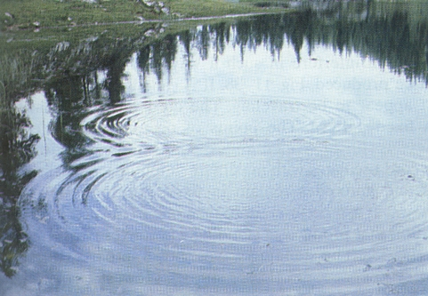
Principle of superposition
Overlapping waves add together
Examples:
People talking at the same time
Shining a flashlight across the room
Ripples on a pond overlapping:

Slide 3
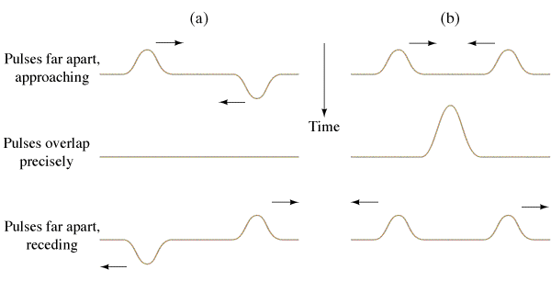
Principle of superposition
Overlapping waves add together
Demo pulses on wave device
Destructive interference
Constructive interference

Slide 4
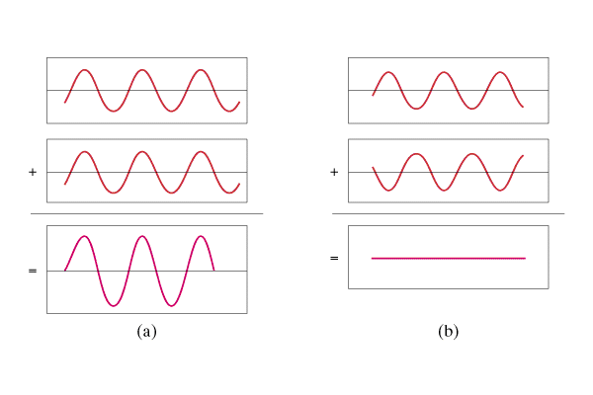
Basic Concept
Superposition - Overlapping waves add.
Constructive interference = crest meets crest
Destructive interference = crest meets trough
Constructive
Destructive

Slide 5
λ
A
B
If the difference in distance from the sources is an integer number of wavelengths, you get constructive interference

Slide 6
λ
A
B
If the difference in distance from the sources is an integer number of wavelengths, you get constructive interference

Slide 7
λ
A
B
If the difference in distance from the sources is an integer number of wavelengths, you get constructive interference
Difference is:
0 λ, 1 λ, 2 λ, 3 λ…

Slide 8
λ
A
B
If the difference in distance from the sources has a remainder of a half wavelength, you get destructive interference:

Slide 9
λ
A
B
If the difference in distance from the sources has a remainder of a half wavelength, you get destructive interference:

Slide 10
λ
A
B
If the difference in distance from the sources has a remainder of a half wavelength, you get destructive interference:
Difference
.5 λ, 1.5 λ, 2.5 λ, 3.5 λ…

Slide 11
Demo – speaker moving ½ wavelength

Slide 12
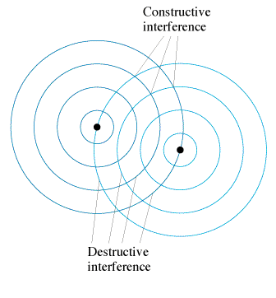
Basic Concept
Two Source Pattern
Constructive:
Crest meets crest
Trough meets trough
Destructive:
Crest meets trough
Demo speakers
Demo Laser Slits

Slide 13
Young’s Double Slit Experiment
Monochromatic, coherent light
Light spreads out from slits
Screen has sum of two sources
Interference pattern on screen

Slide 14
Interference
Sources
L₁
L₂
When the difference in distance (L₁- L₂) is an
integer number of wavelengths (0, 1, 2, 3…) = Constructive
remainder of a half (¹/₂, 1 ¹/₂, 2 ¹/₂, …) = Destructive

Slide 15
To figure out two source problems:
Calculate the λ
Find the difference in distance
Find out how many λ it is
Decide:
__.0 = constructive
__.5 = destructive
__.1 = mostly constructive
__.25 = ???

Slide 16
Interference - Example
Sources
3.21 m
1.22 m
In air where the speed of sound is 350 m/s, two loudspeakers produce a frequency of 700. Hz.
a) what is the wavelength of the sound?
b) if we are 3.21 m from the left speaker, and 1.22 m from the right speaker, is it loud or soft?

Slide 17
Interference
Sources
3.21 m
1.22 m
In air where the speed of sound is 350 m/s, two loudspeakers produce a frequency of 700. Hz.
a) what is the wavelength of the sound?
b) if we are 3.21 m from the left speaker, and 1.22 m from the right speaker, is it loud or soft?
λ = (350 m/s)/(700 Hz) = 0.50 m
(3.21-1.22) = 1.99 m
(1.99 m)/(0.50 m) = 3.98 wavelengths so it is loud.

Slide 18
Whiteboards
1 | 2 | 3 | 4 | 5 | 6 | 7

Slide 19
Two speakers 3.0 m apart are making sound with a wavelength of 48.0 cm.
A. What is the frequency of this sound if v = 343 m/s?
v = f λ,
343 m/s = f (.48 m)
f = 714.5833333
715 Hz

Slide 20
Two speakers 3.0 m apart are making sound with a wavelength of 48.0 cm.
If I am 2.12 m from one speaker, and 3.80 m from the other, is it loud, or quiet, and how many wavelengths difference in distance is there?
3.80 m - 2.12 m = 1.68 m
(1.68 m)/(.48 m) = 3.5 λ = destructive interference
3.5 wavelengths, destructive

Slide 21
Two speakers 3.0 m apart are making sound with a wavelength of 48.0 cm.
If I am 5.17 m from one speaker, and 8.05 m from the other, is it loud, or quiet, and how many wavelengths difference in distance is there?
8.05 m - 5.17 m = 2.88 m
(2.88 m)/(.48 m) = 6.0 λ = constructive interference
6.0 wavelengths, constructive

Slide 22
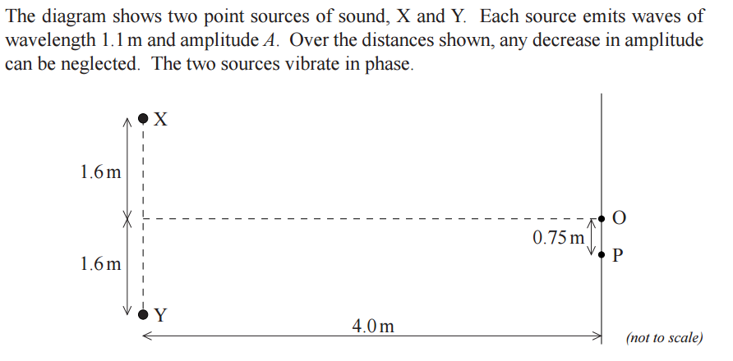
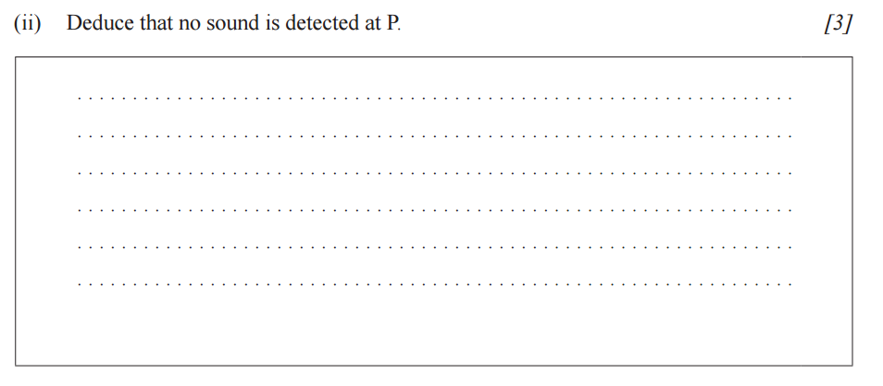

Slide 23
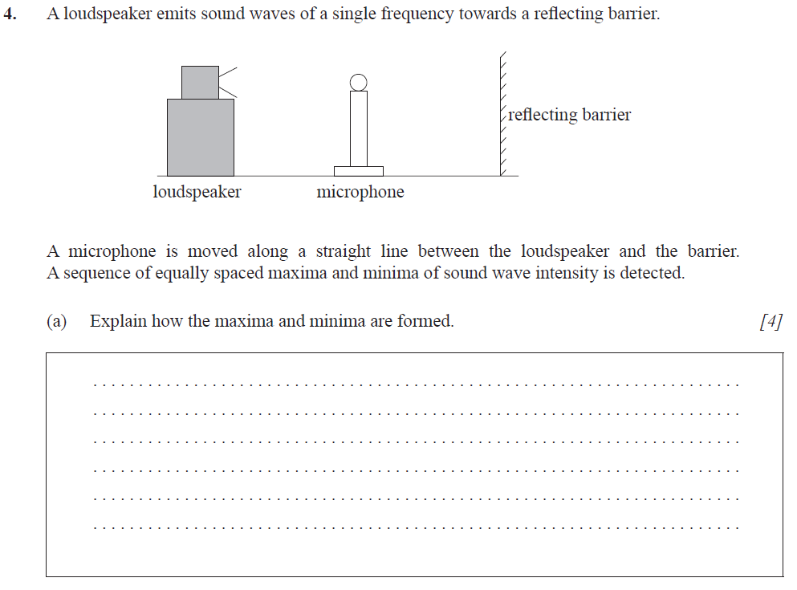
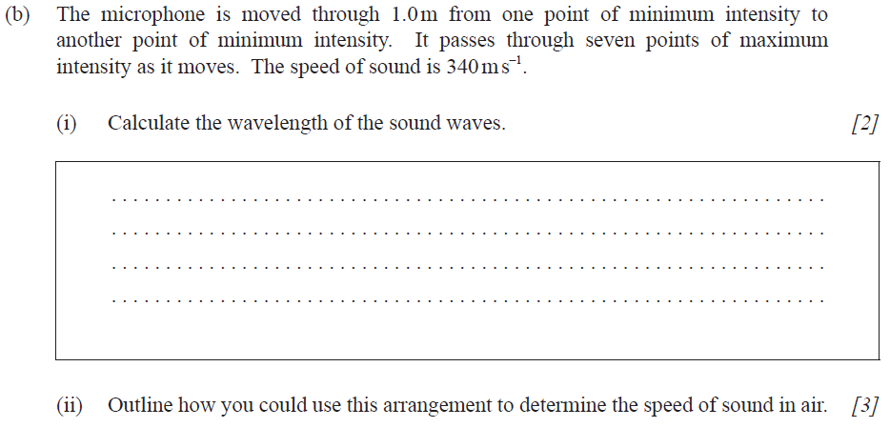

Slide 24
Two speakers 8.0 m apart are making sound with a frequency of 250. Hz in phase where the speed of sound is 335 m/s.
A) What is the wavelength of the sound?
B)If I am 3.56 m from one speaker, and 9.59 m from the other, is it loud or quiet?
1.34 m, 4.5 wavelengths, quiet

Slide 25
Two speakers 11.00 m apart are in phase and making a frequency of 490. Hz where the speed of sound is 343 m/s. If I stretch a string that is 4.00 m long from the center of one of the speakers, and move the end about, what are the closest three distances from the other speaker that will create constructive interference?
7.50 m, 8.20 m, 8.90 m

Slide 27
Two speakers are at opposite ends of an 8.00 m long hall. They emit sound at a frequency of 457.333 Hz, and the speed of sound is 343 m/s.
A. What is the wavelength of the sound?
v = f λ,
λ = v/f = (343 m/s)/(457.333 Hz) = .750 m
.750 m

Slide 28
Two speakers are at opposite ends of an 8.00 m long hall. They emit sound at a frequency of 457.333 Hz, and the speed of sound is 343 m/s.
B. A spot 4.1875 m from one end of the hall has what kind of interference?
L₁ = 4.1875 m
L₂ = 8.00 - 4.1875 = 3.8125 m
(4.1875 m - 3.8125 m) = .375 m = ? λ
(.375 m)/(.750 m) = .5 λ (Destructive)
Destructive

Slide 29
Two speakers are at opposite ends of an 8.00 m long hall. They emit sound at a frequency of 457.333 Hz, and the speed of sound is 343 m/s.
C. What distance separates a point of constructive and a point of destructive interference?
Hmm - you want to go from an even wavelength of distance difference to a even plus one half….
Figure it out yourself

Slide 30
Two speakers 3.0 m apart are making sound with a wavelength of 48.0 cm.
If I am 2.00 m from one speaker, What is the minimum distance I can be from the other speaker to experience constructive interference?
must be a difference in distance of 0, .48, .96, 1.44 m
1.52 works,
1.04 works,
.56 C’est impossible
1.04 m

Slide 31
Two speakers are at opposite ends of an 8.00 m long hall. They emit sound at a frequency of 457.333 Hz, and the speed of sound is 343 m/s.
G. Can there be complete destructive interference if the speakers are moved to within 12 cm of each other? Why or why not?
Seems like there never could be a difference of distance greater than .12 m….
Figure it out yourself

