Slide 1
Buoyant Force
Contents:
How to calculate
Whiteboards

Slide 2
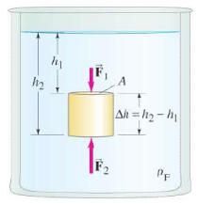
Buoyant force is the weight of displaced water:
ρ_{f} = Density of fluid in kg m⁻³
V_{f} = Volume of displace fluid in m³
g = 9.81 N kg⁻¹
Derive
Demo: Float not float/Cartesian Diver/hot air balloons/hydrometer

Slide 3
Buoyant force is the weight of displaced water:
ρ_{f} = Density of fluid in kg m⁻³
V_{f} = Volume of displace fluid in m³
g = 9.81 N kg⁻¹
What is the buoyant force on a 3.0 cm diameter air bubble under water? ρ_{H2O} = 1.0E3 kg m⁻³
0.14 N

Slide 4
ρ_{f} = Density of fluid in kg m⁻³
V_{f} = Volume of displace fluid in m³
g = 9.81 N kg⁻¹
What is the buoyant force on a 5.45 kg iron shot submerged in water? What is the weight of the shot in air, and what is its apparent weight submerged?
ρ_{Fe} = 7.8E3 kg m⁻³, ρ_{H2O} = 1.0E3 kg m⁻³, ρ = m/V so V = m/ρ
6.85 N, 53.5 N, 46.6 N

Slide 5
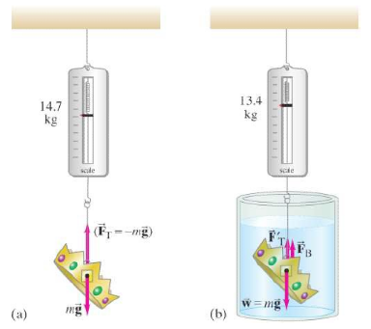
ρ_{f} = Density of fluid in kg m⁻³
V_{f} = Volume of displace fluid in m³
g = 9.81 N kg⁻¹
The King’s crown has a mass of 14.7 kg, but appears to have a mass of only 13.4 kg when weighed when it is submerged in water. What is the density of the crown? Is it gold?
ρ_{Au} = 19.3E3 kg m⁻³, ρ_{H2O} = 1.0E3 kg m⁻³, ρ = m/V so V = m/ρ
11.3x10³ kg m⁻³, so no

Slide 6
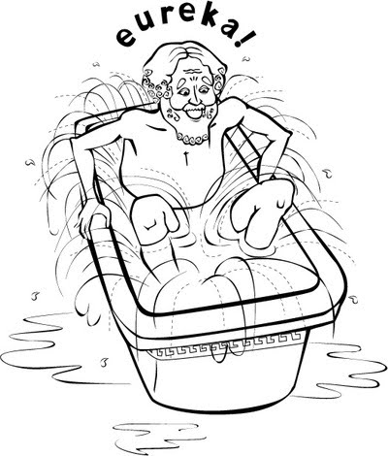
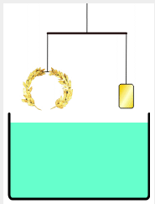
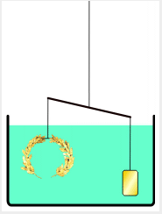
???????

Slide 7
Buoyant Forces
1 | 2 | 3

Slide 8
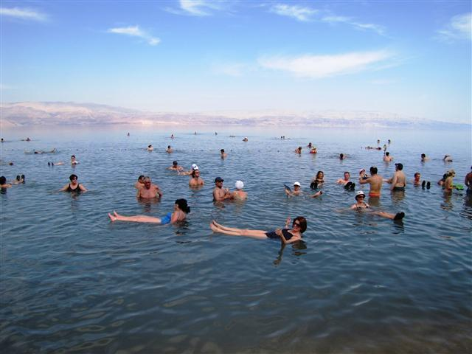
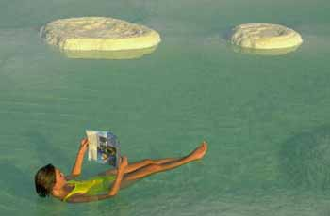
What is the buoyant force on a rectangular block of wood that measures 12x23x15 cm if it is submerged in the Dead Sea where the density of the water is 1240 kg m⁻³?
(convert cm to m first)
50. N

Slide 9
A 15x15x5.0 cm piece of wood floats in water (1000. kg m⁻³) face down in the water with the waterline 3.1 cm up the 5.0 cm side:
What is its mass?
What is its density?
620 kg m⁻³

Slide 10
A 5.0x4.0x4.0 cm piece of wood with a density of 530 kg m⁻³ is tied to the bottom of a pail of water (1000. kg m⁻³) with a string and held completely submerged. What is the tension on the string?
0.37 N

Slide 11
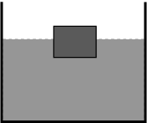
A 25x25x10 cm block of iron (7.80x10³ kg m⁻³) floats on mercury (13.6x10³ kg m⁻³) If one of the 25x25 cm faces is down into the mercury, how far into the mercury does the block sink before coming to equilibrium?
5.7 cm

