Slide 1
Hydrostatic Pressure
Contents:
How to calculate
Whiteboards

Slide 2
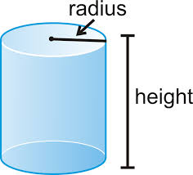
Pressure at some depth in a fluid:
P = Pressure (gauge) in Pa
ρ = Density in kg m⁻³
g = 9.81 N kg⁻¹
h = depth in m
Derive
Demo bucket with holes/Same level tubes/Siphon

Slide 3
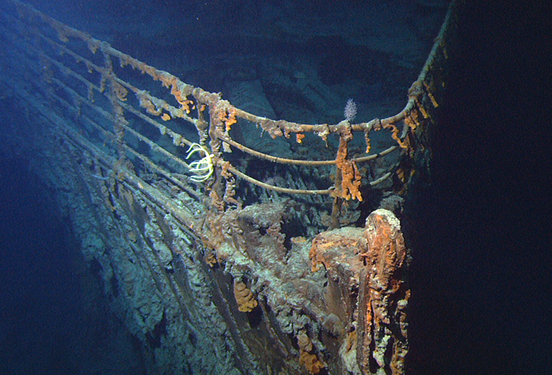
P = Pressure (gauge) in Pa
ρ = Density in kg m⁻³
g = 9.81 N kg⁻¹
h = depth in m
Example – What is the gauge pressure 3800 m (12,500 ft) deep in the ocean where the wreck of the Titanic lies? Calculate it in Pa, PSI and atm. (ρ = 1.025x10³ kg m⁻³)
(3.8E7 Pa, 5.5E3 PSI, 380 atm (377.2 with no sf)) 10 m ≈ 1atm, why it is gauge pressure, what the actual pressure would be

Slide 4
In the data packet:
P = Absolute Pressure in Pa
P_{o} = Atmospheric pressure above fluid Pa
ρ_{f} = Density (of fluid?) in kg m⁻³
g = 9.81 N kg⁻¹
d = depth in m
Example – At what depth below fresh water is the absolute pressure 100. PSI? (P_{o} = 1.013x10⁵ Pa, ρ = 1.00x10³ kg m⁻³)
(59.9 m)

Slide 5
Hydrostatic Pressure
1 | 2 | 3

Slide 6
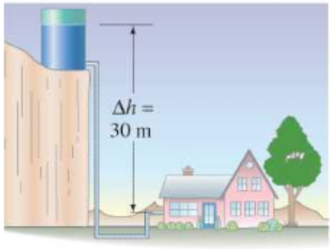
The water level in a water tower is 30. m above the point where a faucet is. What is the absolute pressure in Pa and PSI? (P_{o} = 1.013x10⁵ Pa, ρ = 1.00x10³ kg m⁻³)
What is the gauge pressure in PSI?
P = P_{o} + ρgh
4.0E5 Pa, 57 psi, 43 psi

Slide 7
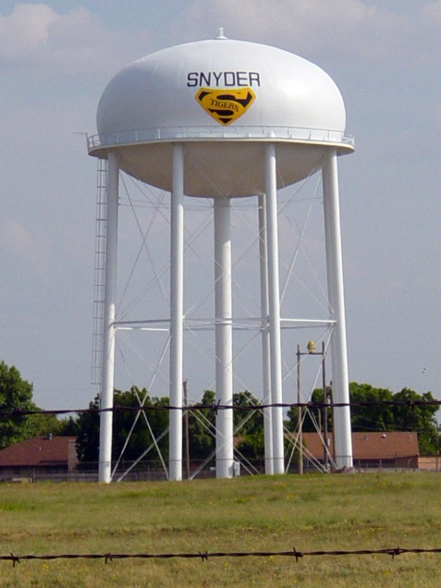
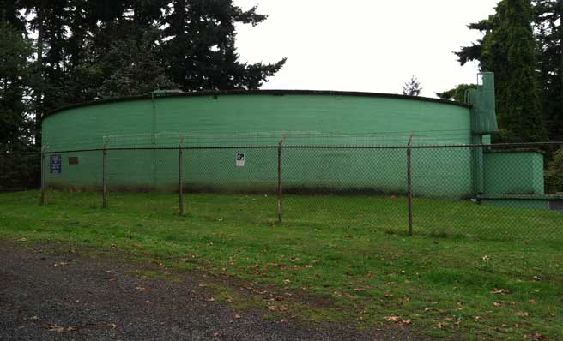
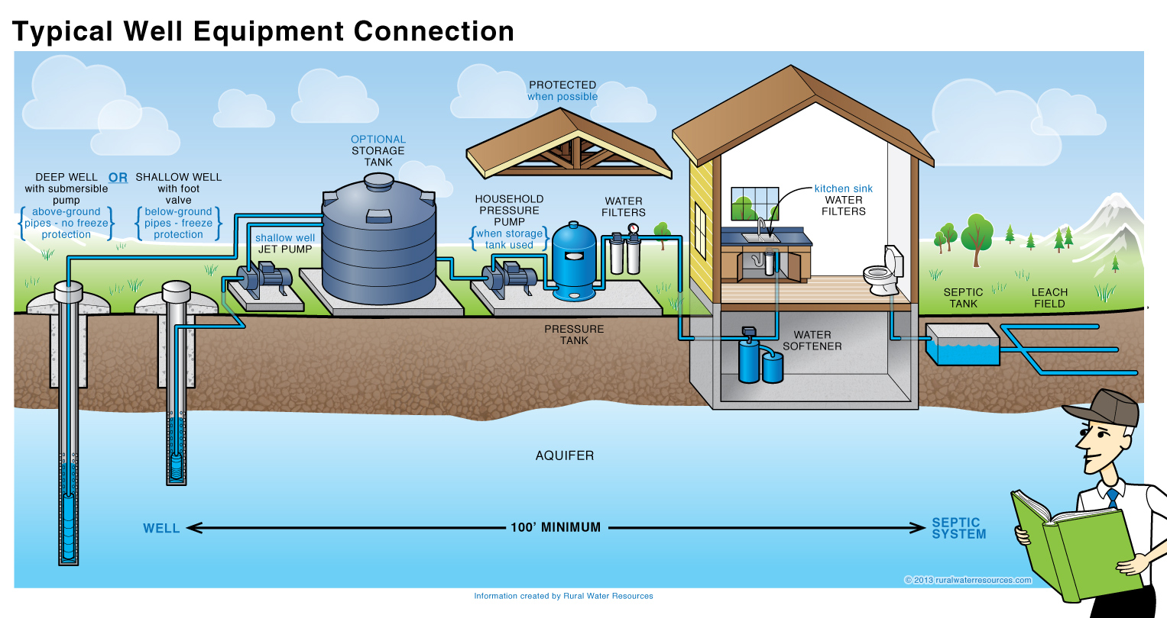

Slide 8
The density of air at STP is 1.29 kg m⁻³. What is the difference in air pressure between the top and the bottom of the 381 m tall Empire State Building in Pa? (assume the density is constant….) ΔP = ρgh
If the pressure is 1.025x10⁵ Pa at the bottom, what is the pressure at the top?
4.82E3 Pa, 0.977E5 Pa (9.77E4 Pa)

Slide 9
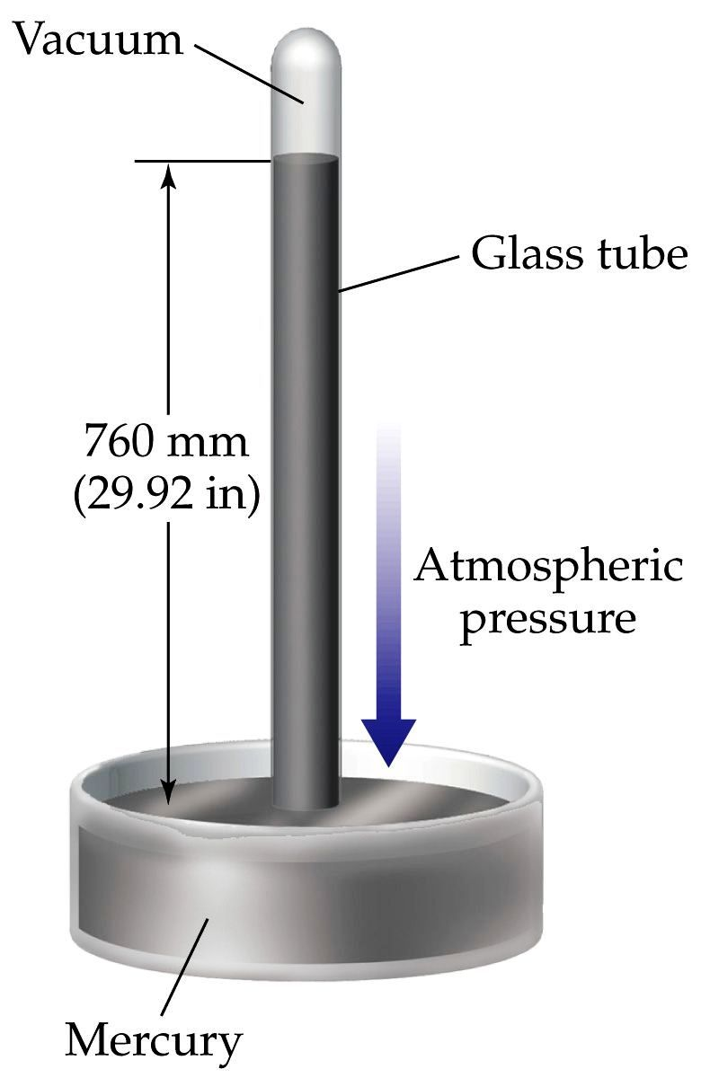
At what depth in mercury is the gauge pressure equal to one atmosphere? (ρ = 13.6x10³ kg m⁻³)
(answer in m and mm ☺)
P = ρgh
1 atm = 1.013 x 10⁵ Pa = 101.3 kPa = 760 Torr = 14.7 psi
0.759 m, 760 mm

Slide 10
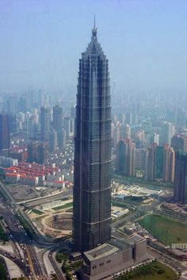
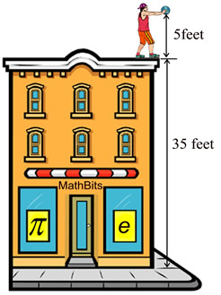
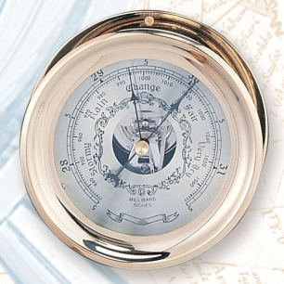
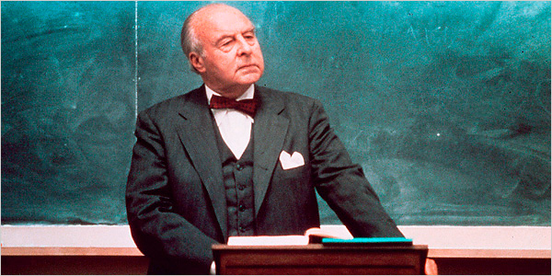
How could one determine the height of a tall building using a very accurate barometer?
Pick the best one:
Measure
Pendulum
String
Shadow
Superintendent
???????
Notes:
MEASURING A BUILDING’S HEIGHT
A Professor of physics asked this question in an examination, “Describe how to find out the height of a skyscraper with a barometer.” The Professor, of course, expected answers that showed some understanding of the Physics he taught about the differences in air pressure at different altitudes.
But, one student’s answer was: “Tie a long piece of string to the neck of the barometer, then lower the barometer from the roof of the skyscraper to the ground. The length of the string plus the length of the barometer will equal the height of the building.” This highly original answer made the Professor r angry and he immediately failed the student.
The student appealed, claiming that his answer was certainly correct, so the university appointed an independent arbiter to decide the case. The arbiter judged that the answer was correct, but did not display any noticeable knowledge of physics.
So, it was decided to give the student six minutes to provide an answer which showed some knowledge of the basic principles of physics. For five minutes the student sat, silently thinking.. The arbiter reminded him that time was running out, and the student replied that he had several very good answers, but couldn’t decide which to use. Finally, he replied as follows, knowing that his answer had to involve using the barometer:
“First, he said, you could take the barometer up to the roof of the skyscraper, drop it over the edge, and measure the time it takes to reach the ground. The height of the building can then be worked out from the formula H = 0.5g x t squared.
“Second, if the sun is shining you could measure the height of the barometer, then set it on end and measure the length of its shadow. Then you measure the length of the skyscraper’s shadow, and thereafter it is simple matter of proportional arithmetic to work out the height of the skyscraper.
“Third, if the skyscraper has an outside emergency staircase, it would be easy to climb up it and, using the barometer like a ruler, mark off how many barometer lengths equal the height of the skyscraper, then add them up.
“Fourth, if you merely wanted to be boring and orthodox about it, of course, you could use the barometer to measure the air pressure on the roof of the skyscraper and on the ground, and convert the difference in millibars into feet to give the height of the building. (The student knew this was the answer the Professor wanted, but continued.)
“Fifth, since we are always being told to use independence of mind and apply scientific methods, obviously the best way would be to knock on the janitor’s door and say to him ‘If you would like a nice new barometer, I will give you this one if you tell me the height of this building’.”

