Slide 1
Pressure
Contents:
How to calculate
Whiteboards
Gauge pressure
Whiteboards

Slide 2
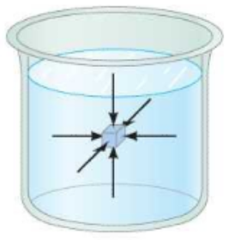
Pressure is in Force per unit area
F = Force in N
A = Area in m²
P = pressure in N/m² (Pascals - Pa)
Show what a Pa is (atm in each Pa, lb/in²)
In a fluid– Same in all directions, perp to walls.

Slide 3
Pressure is in Force per unit area
F = Force in N
A = Area in m²
P = pressure in N/m² (Pascals - Pa)
Example - A 2.4 kg box measures 15 cm by 25 cm on the base. What is the pressure under the box?
(630 Pa – snowshoes vs. spike heels)

Slide 4
Pressure
1 | 2 | 3

Slide 5
What is the pressure of 42 N on a 20. cm x 32 cm plate?
660 Pa

Slide 6
What force does 3.200 kPa exert on a 78.0 cm x 182 cm pane of glass?
4540 N

Slide 7
A hydraulic jack lifts a 31,360 N car using a pressure of 1.38 MPa (M = x 10⁶) What is the diameter of the cylinder?
0.170 m

Slide 8
Converting units of pressure
1 atm = 1.013x10⁵ Pa = 101.3 kPa = 760. torr = 14.7 PSI
(1 bar = 1x10⁵ Pa, so 1 atm = 1.013 bar)
Convert 2.10 atm to Pa: (2.13x10⁵ Pa)
Convert 345 torr to Pa: (4.60x10⁴ Pa)
Convert 2.45x10⁴ Pa to PSI: (3.56 PSI)

Slide 9
Conversions
1 | 2 | 3

Slide 10
Convert 32 psi to kPa
1 atm = 1.013x10⁵ Pa = 101.3 kPa = 760. torr = 14.7 PSI
220 kPa

Slide 11
Convert 890 Torr (mm Hg) to Pa
1 atm = 1.013x10⁵ Pa = 101.3 kPa = 760. torr = 14.7 PSI
1.2x10⁵ Pa

Slide 12
Convert 2000 psi to atm:
1 atm = 1.013x10⁵ Pa = 101.3 kPa = 760. torr = 14.7 PSI
136 atm ≈ 100 atm

Slide 13
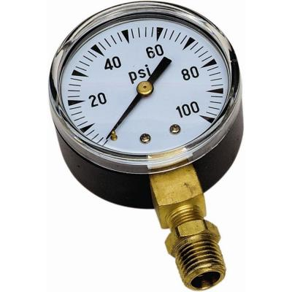
Gauge pressure
Most pressure gauges compare to Atmospheric
Gauge pressure is how much more a pressure is
than atmospheric
(i.e. this room is at 0 Gauge - Absolute P is 1 atm more)
P = P_{gauge} + P_{Atm}
P = Absolute (actual) pressure
P_{gauge} = Gauge pressure
P_{Atm} = Atmospheric pressure

Slide 14
Gauge pressure
P = P_{gauge} + P_{Atm}
P = Absolute (actual) pressure
P_{gauge} = Gauge pressure
P_{Atm} = Atmospheric pressure
1 atm = 1.013x10⁵ Pa = 101.3 kPa = 760. torr = 14.7 PSI
Example 1 – If your tyre pressure gauge reads 220 kPa, what is the actual pressure in the tyre in kPa and Pa?
(320 kPa, 3.2E5Pa)

Slide 15
Gauge pressure
P = P_{gauge} + P_{Atm}
P = Absolute (actual) pressure
P_{gauge} = Gauge pressure
P_{Atm} = Atmospheric pressure
1 atm = 1.013x10⁵ Pa = 101.3 kPa = 760. torr = 14.7 PSI
Example 2 – What is the gauge pressure if you have an actual pressure of 1072 Torr? (312 Torr)

Slide 16
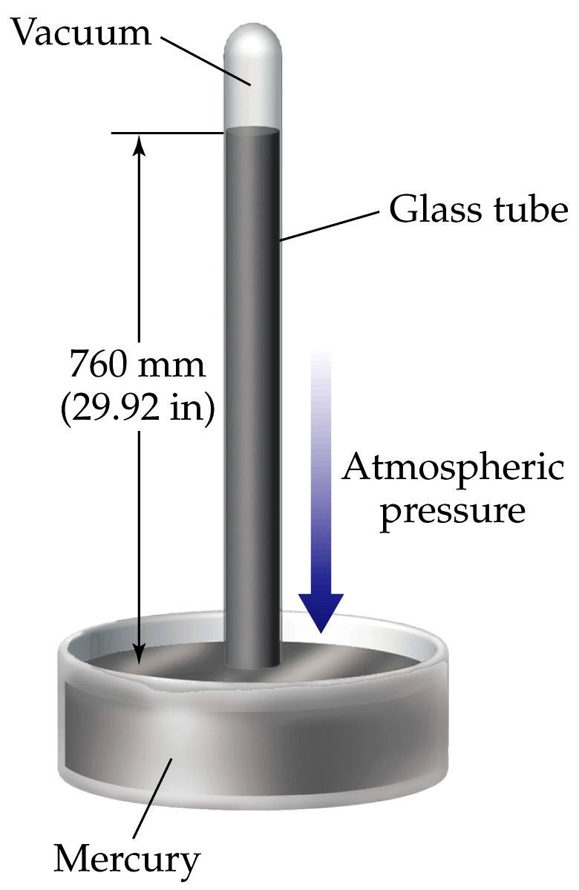
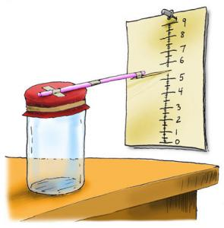
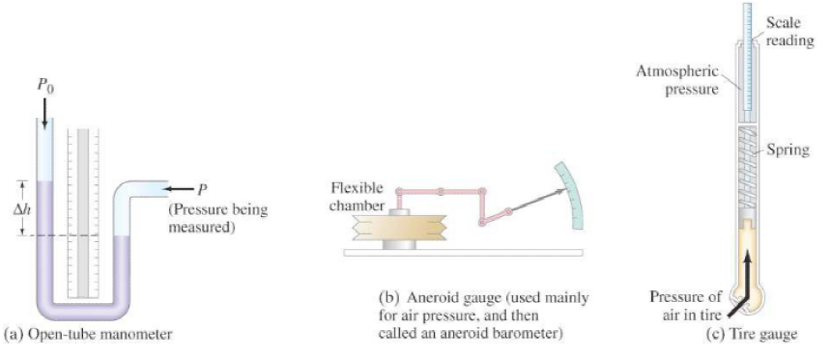
Gauge pressure

Slide 17
Gauge Pressure
1-4

Slide 18
What is the absolute pressure if you read 35 psi gauge? Answer in psi and Pascals
1 atm = 1.013 x 10⁵ Pa = 101.3 kPa = 760 Torr = 14.7 psi
49.7 psi, 3.42E5 Pa

Slide 19
If you have an absolute pressure of 812 Torr, what is the gauge pressure? Answer in Torr
1 atm = 1.013 x 10⁵ Pa = 101.3 kPa = 760 Torr = 14.7 psi
52 Torr

Slide 20
What is the absolute pressure if the gauge pressure is 2.17 x 10⁵ Pa. Answer in Pa.
1 atm = 1.013 x 10⁵ Pa = 101.3 kPa = 760 Torr = 14.7 psi
3.18 x 10⁵ Pa

Slide 21
If you have an absolute pressure of 42.0 kPa, what is the gauge pressure in kPa?
1 atm = 1.013 x 10⁵ Pa = 101.3 kPa = 760 Torr = 14.7 psi
-59.3 kPa

