Slide 1
Density
Contents:
How to calculate
Whiteboards

Slide 2
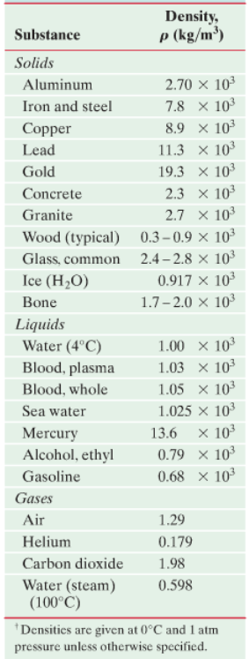
Density is mass per unit volume:
ρ = Density in kg m⁻³
m = mass in kg
V = Volume in m³
Demo - 1 m³ (1 m³ = 1000 liters)
Demo cube and cylinder
Demo diet/non diet
(Specific gravity = ρ/ρ_{water}) float/not float)

Slide 3
Density is mass per unit volume:
ρ = Density in kg m⁻³
m = mass in kg
V = Volume in m³
Example – What is the mass of an iron cannon ball that is 17 cm in diameter? (20. kg)

Slide 4
Destiny
1 | 2 | 3

Slide 5
What is the destiny of a fluid if 2.00 liters of it has a mass of 1.58 kg? (1000 liters = 1 m³)
790 kg m⁻³

Slide 6
What volume (in m³) of mercury has a mass of 1.00 kg? (ρ = 13.6x10³ kgm⁻³)
How many ml is this? (1 m³ = 10⁶ ml)
7.4x10⁻⁵ m³, 74 ml

Slide 7
What would be the mass of a gold brick that measures the same as a standard building brick?
(A regular building brick has a mass of about 2 kg)
(92 x 57 x 203 mm, ρ = 19.3x10³ kgm⁻³)
21 kg

