Slide 1
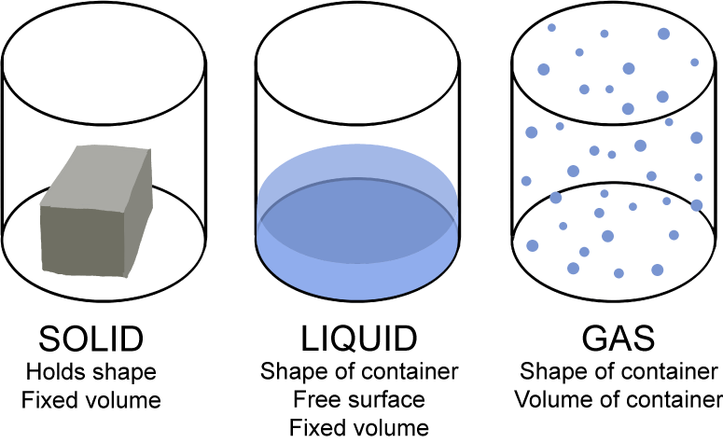
Fluids
Able to flow, Liquids are more dense, incompressible (?)

