Slide 1
Absolute Zero

Slide 2
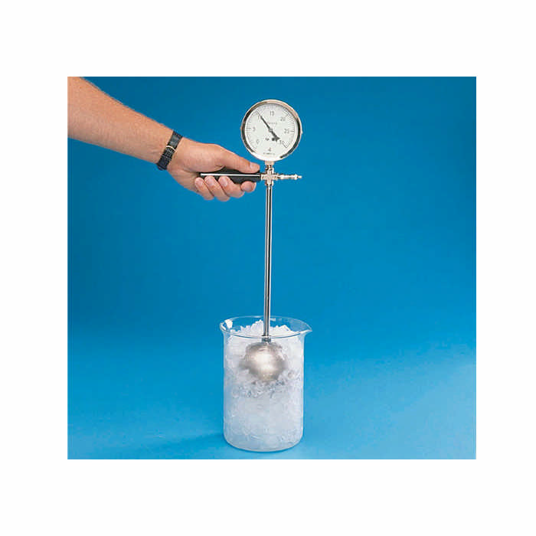
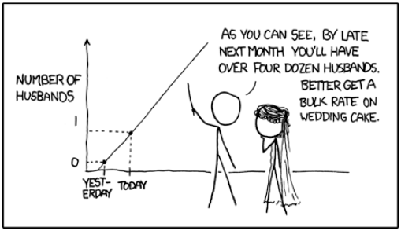
On an Absolute Thermometric Scale
founded on Carnot's Theory of the Motive Power of Heat , and calculated from Regnault's Observations
By Lord Kelvin (William Thomson)
Philosophical Magazine October 1848 [from Sir William Thomson, Mathematical and Physical Papers, vol. 1 (Cambridge University Press, 1882), pp. 100-106.
Temperature-Pressure of Gases Apparatus

