Slide 1
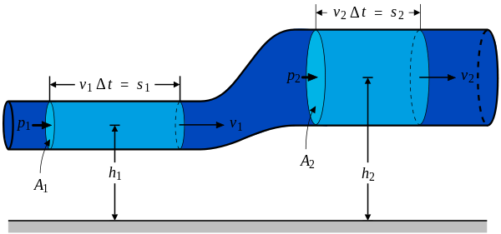
Bernoulli’s Equation:
Derive
P = Pressure in Pa
ρ = Density of fluid in kg m⁻³
g = 9.81 N kg⁻¹
h = Height in m
v = velocity in m/s

Slide 2
Bernoulli’s Equation:
(The Data Packet)

Slide 3
Bernoulli Principle:
Where the velocity is high, the pressure is low
How is it less? – It has to be....why does it speed up/slow down?
What is the molecule spacing?
Standing waves in rivers
Demo –
Venturi tube
Carburetors in cars
2 papers, blowing over one paper
flapping flags, waves (Kelvin-Helmholz instability ) clouds
Blower and water tube/short tube
Funnel and Ping pong ball
Blower and plate
Blower and ball,
airplane wings??? – maybe not

