Slide 1
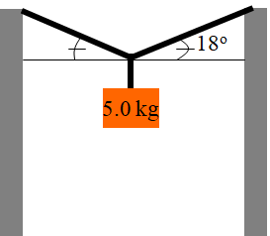
Draw Picture with forces as arrows
Calculate weights (?)
Express/calculate components (SOH CAH TOA)
Set up a <sum of all forces> = 0 equation for x and another for the y direction
Do math.
Find the tension in the lines:

Slide 2
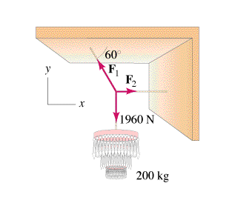
Draw Picture with forces as arrows
Calculate weights (?)
Express/calculate components (SOH CAH TOA)
Set up a <sum of all forces> = 0 equation for x and another for the y direction
Do math.

Slide 3
Find the tensions C and D
C
D
40º
20º
T
12.5 kg
C = 133 N, D = 108 N

Slide 4
Whiteboards:
Force Equilibrium
1-3

Slide 5
T
T
25.0º
25.0º
What is the tension in the two cables?
15.0 kg
Step 3 - Solve for the answer
2Tsin(25º) – 147.15 N = 0, so T = (147.15 N)/(2sin(25º)) = 174.093 N ≈ 174 N
174 N

Slide 6
Find the tensions C and D
C
38º
D
T
17.0 kg
C = 271 N, D = 213 N

Slide 7
24.0º
62.0º
Q
P
Trig Angles
P = 62º
Q = 180-24 = 156º
17.0 kg
Weight of mass:
(17.0 kg)(9.81 N/kg)
166.77 N
Force Equations:
Pcos(62º) + Qcos(156º) = 0
Psin(62º) + Qsin(156º) = 166.77
Solutions
P = 152.7 N
Q = 78.5 N
P = 152.7 N, Q = 78.5 N

Slide 8
y
Q = ?
P ?
61º
31º
x
81º
Find P and Q
34.0 N
Q = 26 N, P = 21 N

