Slide 1
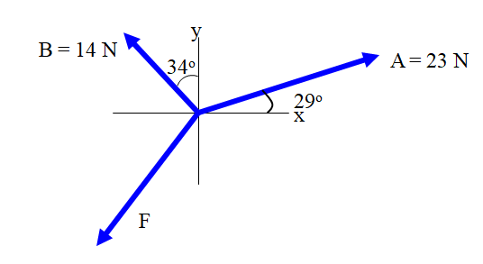
Find F, and θ such that the system will be in equilibrium (This force is called the equilibrant)
X:
Y:

Slide 2
Find the equilibrant for the forces indicated. Express as a magnitude and an angle
y
A = 15.0 N
23.0º
x
42.0º
B = 35.0 N
22.3 N at 64.5º above the positive x axis

