Slide 1
#. Question

Slide 2
#. Question

Slide 3
#. Question

Slide 4
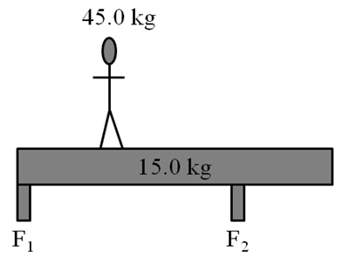
4. The beam is 9.00 m long, and F₂ is 3.00 m from the right side, and the person is 3.00 m from the left side. Find the forces exerted by the supports. (F₁ = 258 N up, F₂ = 331 N up)

Slide 5
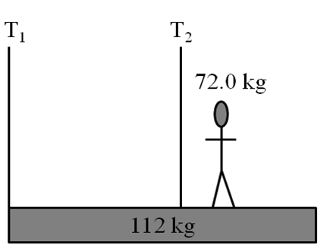
5. The beam is 12.0 m long, the second cable is attached 7.00 m from the left side, and the person is standing 4.00 m from the right side. Find the tensions in the cables.
(F₁ = 56.1 N up, F₂ = 1750 N up)

Slide 6
#. Question

Slide 7
#. Question

Slide 8
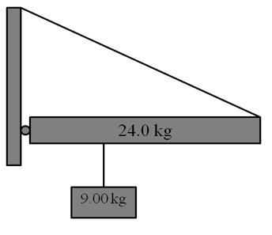
8. The cable makes an angle of 25.0º with the 16.0 m long beam. The sign hangs 5.20 m from the left side of the beam. Find the tension in the cable, and the horizontal and vertical components of the force exerted by the wall. Be sure to give the direction of the components.
(T = 346 N, Wx = 314 N right, Wy = 177 N up)

Slide 9
#. Question

Slide 10
#. Question

Slide 11
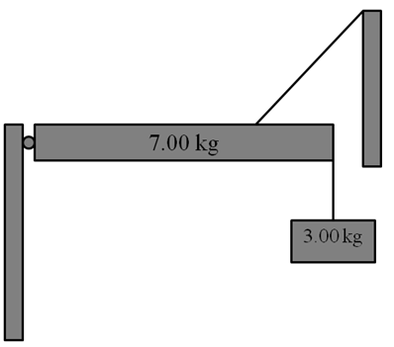
11. The cable is connected 1.50 m from the left side, and makes an angle of 48.0º with the 2.00 m long beam. Find the tension in the cable, and the horizontal and vertical components of the force exerted by the wall. Be sure to give the direction of the components.
(T = 114 N, Wx = 76.6 N left, Wy = 13.1N up)

Slide 12
#. Question

