Slide 1
Formative Assessment

Slide 2
1. Find the Equilibrant (The third force that would cause translational equilibrium) – express it as an angle magnitude vector. Draw it with its tail on the origin, and label its magnitude, and an angle with one of the axes. Write your answer with 3 sig figs, but carry at least 4 so you don’t make rounding errors.
31.0º
y
B = 23.0 N
42.0º
A = 17.0 N
x
(32.4 N, at 270.8º Trig Angle, 0.8º to the right of the -y axis)

Slide 3
2. Find the tensions in the cables C and D. Set up your x and y equations where indicated and solve.
C
D
34.0º
56.0º
35.0 kg
X:
Y:
(C = 192 N, D = 285 N)

Slide 4
P9.1

Slide 5
1. Find the third force (the equilibrant) that would prevent the system from accelerating. 23.16 N At 292.8º Trig angle. (22.8º to the right of the -y axis)
already

Slide 6
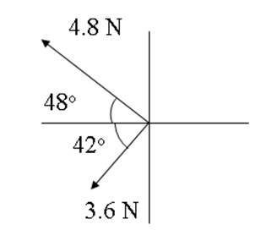
2. Find the third force (the equilibrant) that would prevent the system from accelerating. 6.000 N At 348.9º Trig angle. (11.1º below the +x axis)

Slide 7
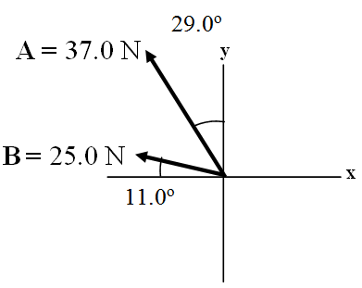
3. Find the third force (the equilibrant) that would prevent the system from accelerating. 56.4 N @ 318.8º Trig angle. (41.2º below the +x axis)
already

Slide 8
4. Cable A makes an angle of 63.0º with the horizontal, and B makes an angle of 23.0º with the horizontal. What is the tension in each cable for there to be no acceleration of the system?
A = 606 N
B = 299 N
already

Slide 9
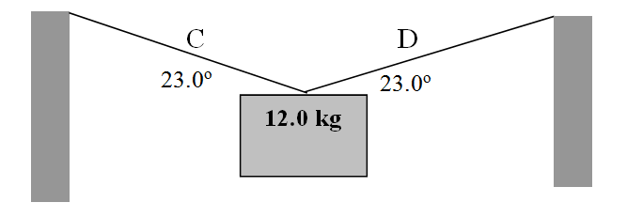
5. Find the tensions in Cable C and D:
C = 151 N
D = 151 N
already

Slide 10
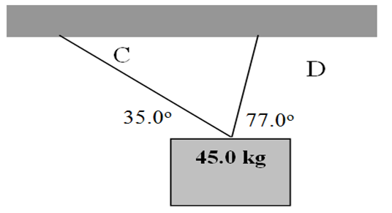
6. Find the tensions in Cable C and D:
C = 107 N
D = 390. N

Slide 11
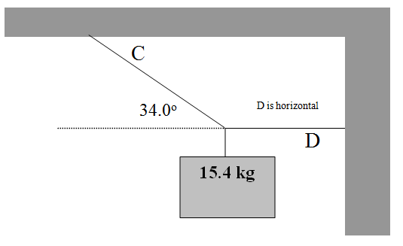
7. Find the tensions in Cable C and D:
C = 270. N
D = 224 N
already

Slide 12
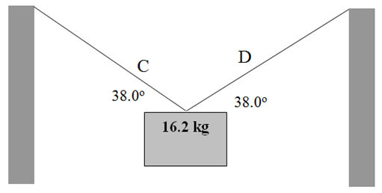
8. Find the tensions in Cable C and D:
C = 129 N
D = 129 N

Slide 13
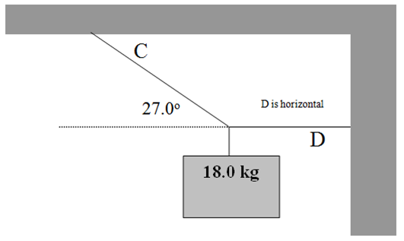
9. Find the tensions in Cable C and D:
C = 389 N
D = 347 N

Slide 14
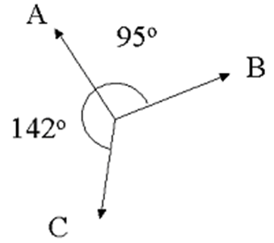
10. Cable A has a force of 23 N along it, what must be the tensions in cable C and B for there to be no acceleration of the system?
B = 17 N
C = 27 N

Slide 16
question

