Slide 1
Formative Assessment

Slide 2
1. A 130. gram uniform meter stick has a 22.0 g clamp on the 23.0 cm mark, where would you clamp a 35.0 g clamp to make the meter stick balance at the 52.0 cm mark? (77.7 cm mark)

Slide 3
2. A uniform 320. g rod is 210. cm long, and has a 120. g mass 60.0 cm from the left end. What mass must you put 190. cm from the left end so that it balances at 140. cm from the left? (416 g)

Slide 4
3. What force in what direction would put this system in torque equilibrium about the pivot? (0.643 N downwards)
4.50 N
12.0 cm
16.0 cm
18.0 cm
F = ?
2.00 N

Slide 5
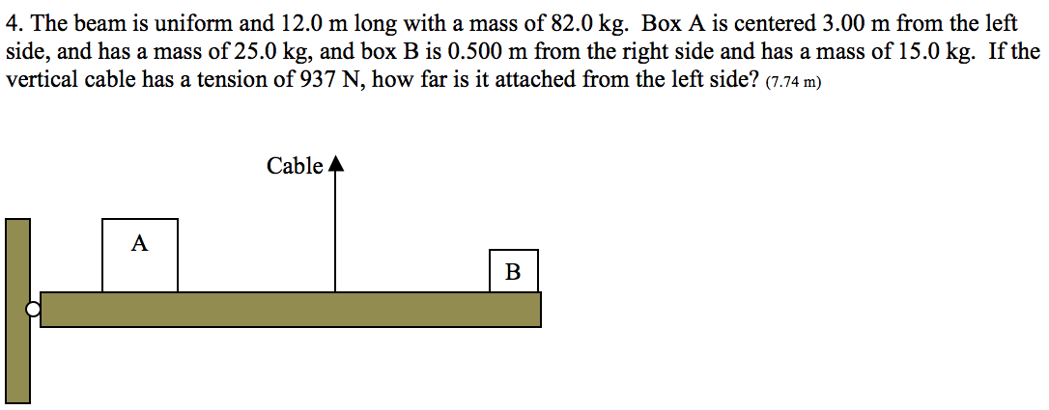

Slide 6
1a: 8. Someone puts a 45 gram clamp at the 12 cm mark and a 75 gram clamp at the 60 cm mark of a 82 gram meter stick. Where is the COM of the system now? (don't forget the meter stick itself) (At the 45.2 cm mark)

Slide 7
2a 9. A 112 g uniform meter stick has a 14.0 g clamp at the 40.0 cm mark. Where would you clamp a 21.0 g clamp to make it balance at the 55.0 cm mark? (91.7 cm mark)

Slide 8
2a 10. A 108 g uniform meter stick balances at the 44.0 cm mark when there is a 13.0 g clamp at the 85.0 cm mark and a what mass clamped at the 12.0 cm mark? (36.9 g)

Slide 9
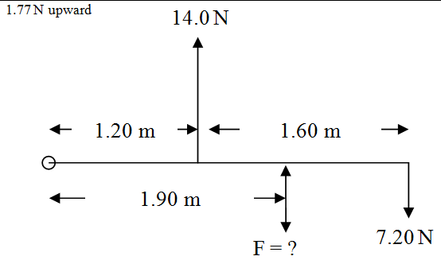
3a 1

Slide 10
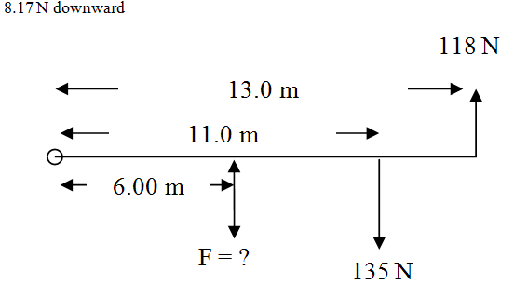
3b 2

Slide 11
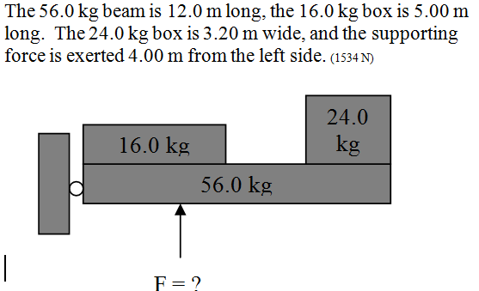
4a

Slide 12
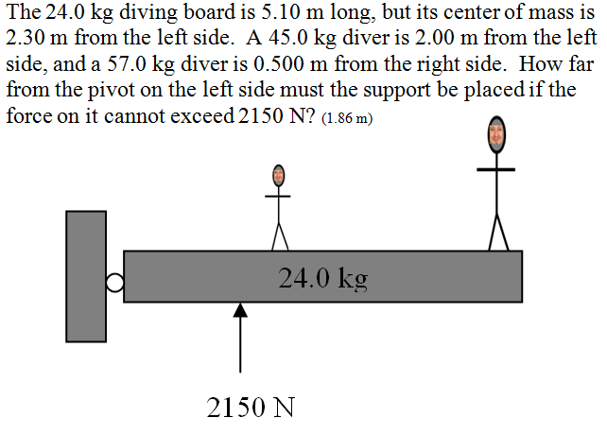
4b

Slide 13
question

Slide 14
P9.2

Slide 15
0.73 Kg
1. The center of mass between two objects is 12 cm from the one with a mass of 3.4 Kg. What is the mass of the other one if it is 56 cm from the COM?

Slide 16
1.02 x10³² Kg
2.A star is seen rotating about a point that is 4.2 x 10⁹ m from its center. We can tell by its light output that it has a mass of 7.5 x 10³¹. What is the mass of the black hole in orbit around the star if it is 3.1 x 10⁹ m from the COM?

Slide 17
22.7 cm
3. How far is the COM from the larger of a 12 lb bowling ball and a 10 lb bowling ball that are 50 cm distant?

Slide 18
37.5 cm
4. A 5 Kg mass is on the 0 end of a meter stick, and a 3 Kg mass is on the 100 and of the stick. Where is the COM? (Neglect the mass of the meter stick)

Slide 19
18.5 feet
5. A 165 lb and 120 lb person sit on a see saw that is 32 feet long. How far is the balance point from the lighter person?

Slide 20
4.49x10² km
6. How far is the center of mass of the sun and Earth from the center of the sun? (The Earth-Sun distance is 1.50x10¹¹ m - the sun has a mass of 1.99 x 10³⁰ Kg, and Earth has a mass of 5.97 x 10²⁴ Kg.)

Slide 21
At the 36.3 cm mark
7. Someone clamps a 50 gram mass to the 15 cm mark of a 78 gram meter stick. Where is the center of mass of the meter stick and mass? (Treat the meter stick as a 78 gram mass at the 50 cm mark)
More than two objects:

Slide 22
At the 45.2 cm mark
8. Someone puts a 45 gram clamp at the 12 cm mark and a 75 gram clamp at the 60 cm mark of a 82 gram meter stick. Where is the COM of the system now? (don't forget the meter stick itself)
already

Slide 23
91.7 cm mark
9. A 112 g uniform meter stick has a 14.0 g clamp at the 40.0 cm mark. Where would you clamp a 21.0 g clamp to make it balance at the 55.0 cm mark?
already

Slide 24
36.9 g
10. A 108 g uniform meter stick balances at the 44.0 cm mark when there is a 13.0 g clamp at the 85.0 cm mark and a what mass clamped at the 12.0 cm mark?
already

Slide 25
7.98 x 10⁵ m
11. How far is the COM of the four inner planets and the sun from the center of the sun? (If they all lined up)

Slide 26
66 feet from the ground
12. Where is the COM of a 120 foot, 495 lb ladder with a 220 lb fireman 12 feet up, a 170 lb fireman 50 feet up and a 150 lb fireman all the way at the top? (The COM of the ladder is 80 feet from the ground)

Slide 27
8.4 feet from the stern
13. Where is the COM of a loaded 89 lb 18 foot canoe when there is a 160 lb person 1.5 feet from the stern, a 90 lb pack 9 feet from the stern, and a 140 lb bow person 15.5 feet from the stern? (Consider the canoe to be symmetric)

Slide 28
55.6 cm mark
14. Where is the COM of a 121 g uniform meter stick if there is a 12.0 g clamp at the 7.00 cm mark, a 34.0 g at the 23.0 cm mark and a 56.0 gram clamp at the 98.0 cm mark?

Slide 29
9.80 cm mark
15. A 68.0 g uniform meter stick has a 15.0 g clamp on the 17.0 cm mark, and it balances at the 32.0 cm mark. Where do you need to clamp a 45.0 g clamp to effect this?

Slide 30
137 g
16. A 145 g meter stick balances at the 66.6 cm mark. There is a 12.0 g clamp on the 92.0 cm mark, and what mass clamped at the 82.0 cm mark?

Slide 31
17. (Extra credit) Devise a way to construct the center of mass of any triangle using a straight edge, and a compass. Explain this method. (Cut out your triangle from cardboard, and see if it balances on that point you've found. If it doesn't...try again)

Slide 32
torsional EQ

Slide 33
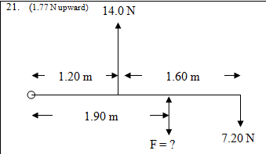
already

Slide 34
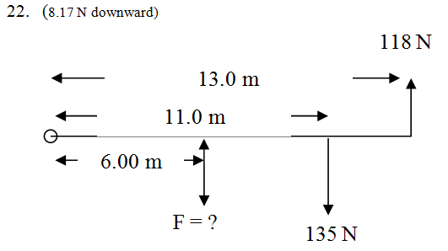
already

Slide 35
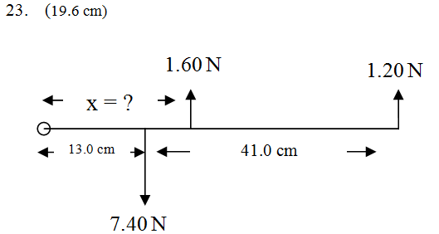

Slide 36
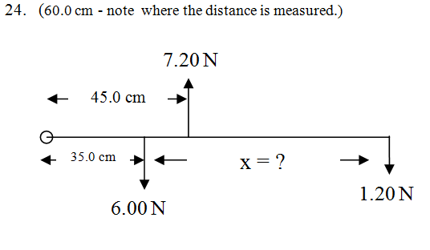

Slide 37
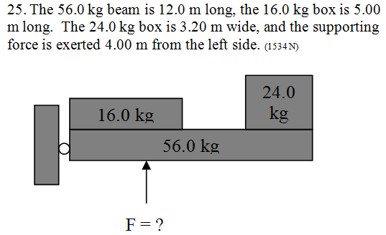
already

Slide 38
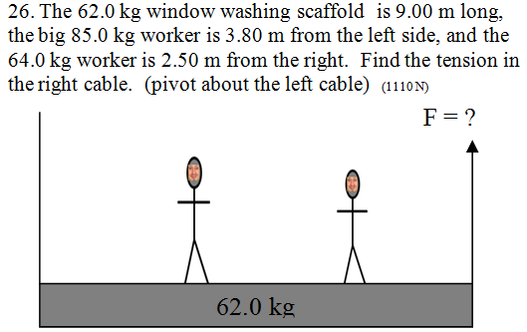

Slide 39
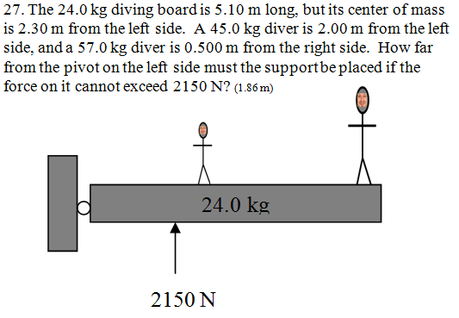
already

Slide 40
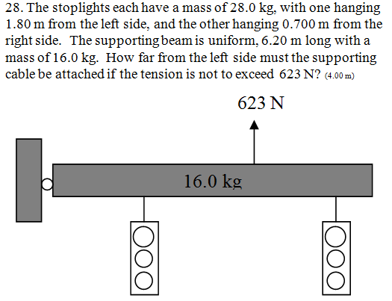

Slide 42
question

