Slide 1
Force Equilibrium:
Draw Picture/Draw Arrows for forces
Calculate weights
Express/calculate components
Set up a <sum of all forces> = 0 equation for x and another for the y direction
Torque Equilibrium:
Pick a Pivot Point
(at location of unknown force)
Express all torques:
±rF ± rF ± rF… = 0
+ is CW, - is ACW
r is distance from pivot
Do Maths

Slide 2
The beam is 6.0 m long, 45 kg and uniform. The person is standing 0.50 m from the right side, and F₂ is 4.0 m from the left side.
Find F1 and F2
64.0 kg
F₁
F₂
F1 = 125.08 N down, F2 = 1194.4 N up

Slide 3
The beam is uniform and 4.00 m long, the cable is attached 2.30 m from the left side at a 30.0º angle with the beam. Find T, Wx, Wy
12.0 kg
5.00 kg
T = 375 N, Wx = 325 N right, Wy = 20.9 N down

Slide 4
2655.3 N, 1407.1 N right, 2015.5 N up
Find T, Wx, Wy
5.0 m
85 kg
58º
1.0 m
350 kg
12.0 m

Slide 5
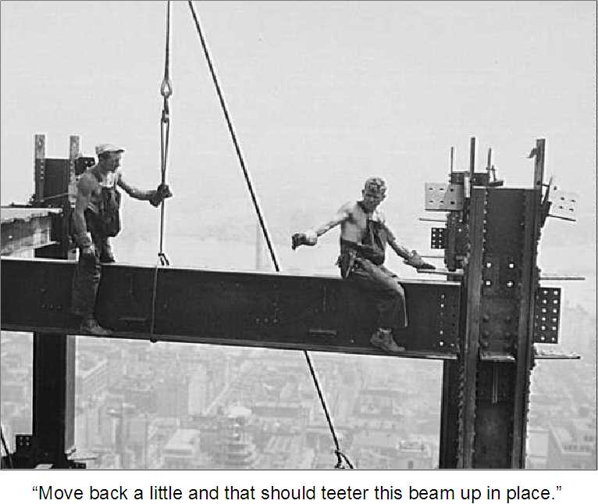

Slide 6
Whiteboards:
Trans and Tors
1 2 3 4

Slide 7
Beam is 18.0 m long, person is 5.0 m from the right side. Find the two tensions in the cables at either end.
T₁
T₂
77 kg
52 kg
T₂ = 801 N, T₁ = 465 N

Slide 8
20.0m
16.0m
15 kg
T
35 kg
7.0m
(Fulcrum)
Find the tension in the cable
and the upward force from the fulcrum. (hint – torque about the fulcrum – you will need to figure out the distances)
T = 181 N, Fy = 309 N up

Slide 9
12.0kg
The beam is uniform and 8.00 m long, the strut is attached 3.20 m from the left side at a 52.0º angle with the beam. The box is centered 1.50 m from the beam’s right side. F, Wx, Wy
18.0kg
F = 584 N, Wx = 359 N left, Wy = 166 N down

Slide 10
The beam is uniform and 6.00 m long, the mass is hung 2.00 m from the left side. Cable makes a 20.0º angle with the horizontal. T, Wx, Wy
85.0kg
41.0kg
T = 1611 N, Wx = 1514 N left, Wy = 685 N up

Slide 11
The 10.0 kg beam is uniform and 8.00 m long and makes an angle of 35.0º with the wall, the cable is attached 3.80 m from the bottom end.
Find the tension in the cable
and the force exerted by the wall in the x and y direction
(Careful what angle you use for the tension)
14.0 kg
T = 274.8 N, Wx = 274.8 N right, Wy = 235.4 N up

Slide 12
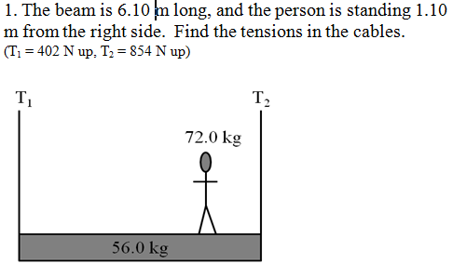

Slide 13
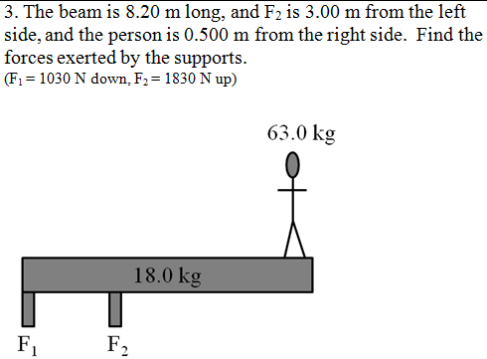

Slide 14
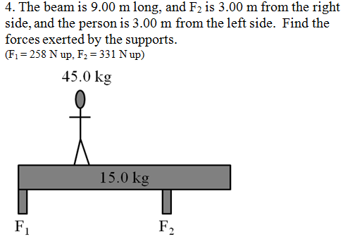

Slide 15
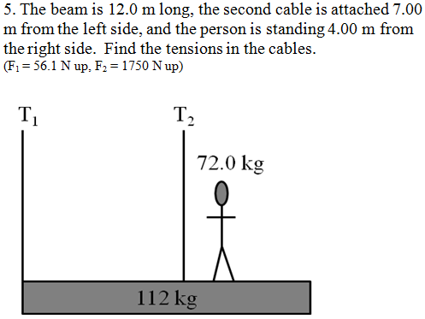

Slide 17
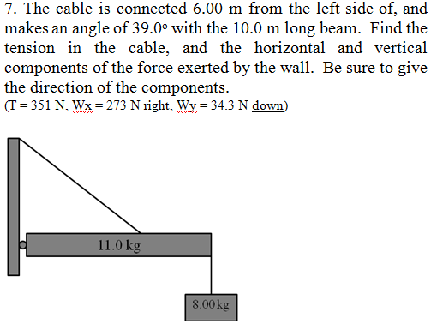

Slide 18
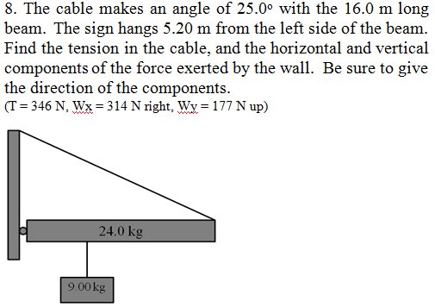

Slide 19
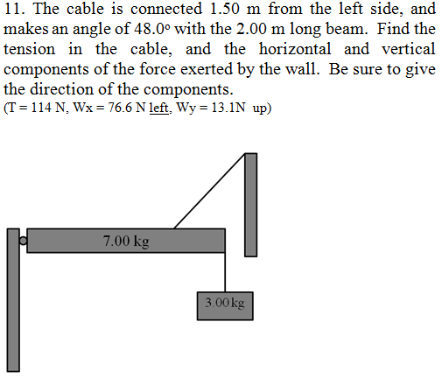

Slide 20
