Slide 1
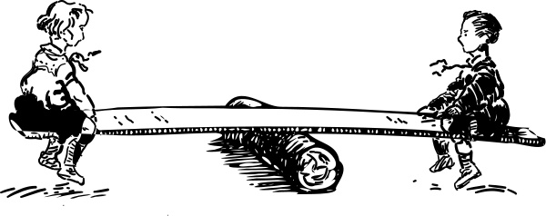
L
X
m₁
m₂

Slide 2
Finding the COM:
Teeter Totter equation in general: (weighted average!)
m₂
m₁
m₃
X₁
X₂
X₃

Slide 3
Example: Find the distance the COM is from the left side of the beam. The 45.0 kg uniform beam is 14.0 m long, has a 12.0 kg box 4.0 m from the left side, and a 30.0 kg box centered 13.0 m from the left side.
30.0 kg
12.0 kg
45.0 kg
4.0 m
13.0 m
7.0 m
8.66 m from the left side

Slide 4
Whiteboards:
Center of mass
1 | 2 | 3 | 4 | 5

Slide 5
The center of the 5.00 kg is 34.0 cm from the center of the 2.00 kg. How far from the 5.00 kg center is the COM? (hint: X_{5kg} = 0)
5 kg
2 kg
34.0 cm
solution
9.71 cm

Slide 6
How far is the COM of the earth moon system from the center of the earth?
Earth’s mass: 5.97x10²⁴ kg
Moon’s Mass: 7.36x10²² kg
Earth-Moon Distance: 3.84x10⁸ m
(The earth’s radius is 6.38x10⁶ m. Is this COM closer to the center or the surface of the earth?)
solution
4.68x10⁶ m

Slide 7
A uniform meter stick has a mass of 85.0 grams, and I place a 15.0 gram clamp at the 24.0 cm mark, and the 55.0 cm mark. At what mark would it balance? (Assume the meter stick to have a COM at 50.0 cm)
solution
47.3 cm

Slide 8
A uniform meter stick has a mass of 116 grams, and has a 24.0 g mass at the 40.0 cm mark. Where do you clamp a 32.0 g mass to make it balance at the 42.0 cm mark?
solution
14.5 cm

Slide 9
A uniform meter stick has a mass of 95.0 grams, and has a 12.0 g mass at the 13.0 cm mark. What mass do you put at the 85.0 cm mark to make it balance at the 56.0 cm mark?
solution
37.4 g

