Slide 1
Formative Assessment

Slide 2
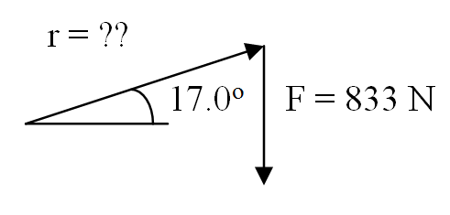
1. A mechanic needs to exert 385 mN of torque. He weighs 833 N and he stands on the handle of his wrench that is making a 17.0º angle above the horizontal. How far from the center must he stand? (Be careful what you use for the angle) (0.483 m)

Slide 3
2. What is the acceleration of a flywheel with a moment of inertia of 0.145 kg m² if a torque of 2.80 mN acts on it? (19.3 rad/s/s)

Slide 4
3. A 0.680 m diameter flywheel has a moment of inertia of 0.243 kg m². What is the angular acceleration of the flywheel if you exert 4.50 N tangentially at the edge to speed it up? (6.29 rad/s/s)

Slide 5
4. A 0.210 m radius grinding disk is spinning at 1350 RPM. If it goes through 85.0 rotations being brought to rest by a 1.20 N frictional force applied tangentially at its edge, what is the moment of inertia of the disk? (0.0135 kg m²)

Slide 6
5. A 4.30 m diameter (cylindrical) merry go round going 45.0 RPM stops in 37.0 rotations because of an 8.30 N force applied tangentially at the edge. What is the mass of the merry go round?
(162 kg)

Slide 7
more

Slide 8
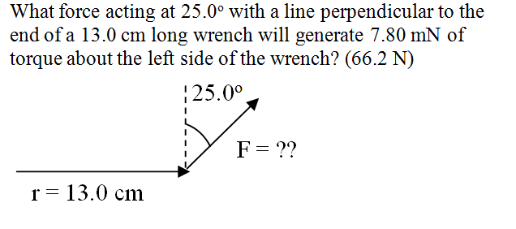

Slide 9
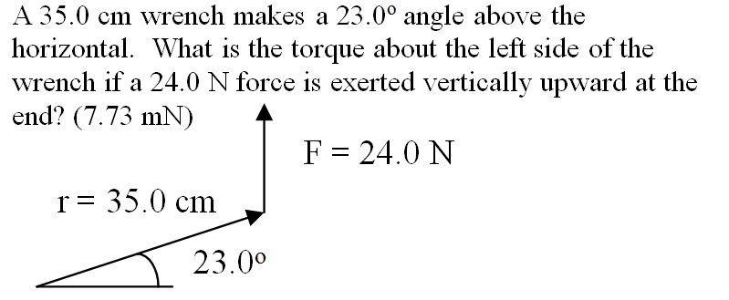

Slide 10
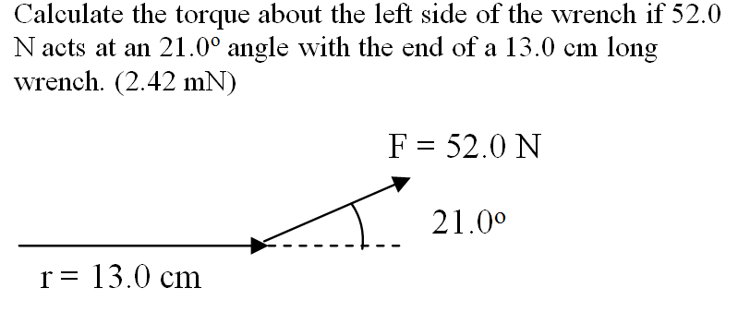

Slide 11
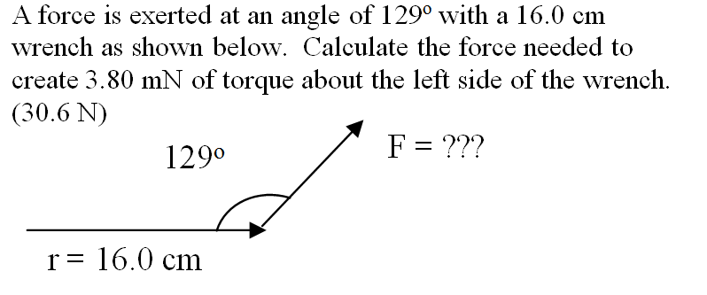

Slide 13
1. A baton requires 5.70 mN of torque to accelerate at 18.4 rad/s/s about its center. What is the moment of inertia? (0.310 kgm²)

Slide 14
2. A flywheel with a moment of inertia of 0.859 kg m² accelerates at 13.0 rad/s/s. What is the torque? (11.2 mN)

Slide 15
3. A motor with 43.0 mN of torque accelerates at 153 rad/s/s. What is its moment of inertia? (0.281 kgm²)

Slide 16
4. A torque of 21.0 mN acts on a motor with a moment of inertia of 1.53 kg m². What is the angular acceleration? (13.7 rad/s/s)

Slide 17
5. What torque will accelerate a motor with a moment of inertia of 3.87 kg m² at 6.60 rad/s/s? (25.5 mN)

Slide 19
6. A 0.400 m diameter, 4.30 kg sphere accelerates about its center at 6.80 rad/s/s. What is the torque? (0.468 mN)

Slide 20
7. A drill with a moment of inertia of 0.0180 kg m² is slowed by a frictional torque of 0.270 mN. If it is moving at 142 rad/s, how many radians will it go through before it stops? (672 rad)

Slide 21
8. A grinding wheel with a diameter of 0.640 m and a moment of inertia of 0.172 kg m² decelerates at -8.90 rad/s/s because of a tangential friction force applied at the edge. What is this force?
(4.78 N)

Slide 22
9. A torque of 19.0 mN acts on a flywheel with a moment of inertia of 3.20 kg m². If it starts at rest, in what time will it go through 16.0 radians? (2.32 s)

Slide 23
10. A torque of 3.50 mN acts on a 7.10 kg, 0.132 m diameter shot put. (a sphere) What is the angular acceleration of the sphere?
(283 rad/s/s)

Slide 25
11. A 0.219 m diameter bowling ball has a tangential force 5.50 N acting on it and it accelerates from rest going through 13.0 rotations in 3.21 seconds. What is the moment of inertia of the ball?
(0.0380 kgm²)

Slide 26
12. A 0.310 m radius flywheel (essentially a thin ring) with a mass of 3.20 kg. What is its rate of deceleration if you exert a force of 2.20 N tangentially at its edge? (2.22 rad/s/s)

Slide 27
13. A flywheel is a 13.2 kg 1.80 m diameter thin ring. If you exert a force of 51.0 N tangentially at its edge, what is its angular acceleration? (4.29 rad/s/s)

Slide 28
14. A flywheel that is a 0.730 m diameter thin ring with a mass of 16.0 kg would require what torque to accelerate from rest to 1120 RPM in 8.10 seconds? (30.9 mN)

Slide 29
15. What is the moment of inertia of a 0.258 m radius flywheel if when you exert a tangential force of 11.5 N at the edge it accelerates from rest to 680. RPMs in 123 rotations? (0.904 kgm²)

Slide 31
16. A 161 kg 4.72 m diameter (cylindrical) merry go round is sped up from rest by a 25.0 N force applied tangentially at its edge. What is its speed in RPMs after 38.0 seconds? (47.8 RPM)

Slide 32
17. A 2.10 m radius, 351 kg (cylindrical) merry go round spinning at 75.0 RPM slows to a halt in 11.5 rotations. What force applied tangentially at the edge would cause this? (157 N)

Slide 33
18. A 232 kg 4.10 m diameter (cylindrical) Merry go round is stopped from a speed of 94.0 RPM in 55.0 seconds. What frictional force applied tangentially at the edge would cause this? (42.6 N)

Slide 34
19. A 243 kg 1.70 m radius (cylindrical) merry go round stops from a speed of 68.0 RPM because of a frictional force applied at the edge of 8.50 N. How many rotations does it go through in stopping?
(98.1 rotations)

Slide 35
20. A 4.60 m diameter (cylindrical) merry go round speeds up from rest going through 5.10 rotations in 41.0 seconds because of a 15.0 N force applied tangentially at the edge. What is the mass of the merry go round? (342 kg)

