Slide 1
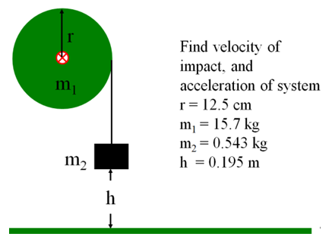
Pulleys and such
a = 0.6347 m/s/s, v = 0.49751 m/s

Slide 2
A string is wrapped around a 12.0 cm radius 4.52 kg thin ring. A mass of 0.162 kg is hanging from the end of the string. What is the acceleration of the system, and what is the velocity of m2 when it has fallen 1.00 m? (Assume it is released from rest)
r
m₁
m₂
0.339 m/s/s, 0.824 m/s

Slide 3
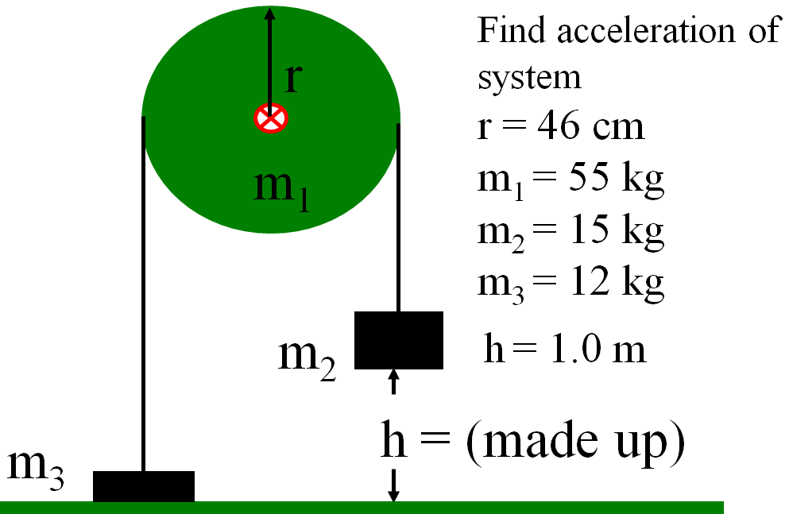
0.540 m/s/s, 1.039 m/s if h = 1.00 m

Slide 4
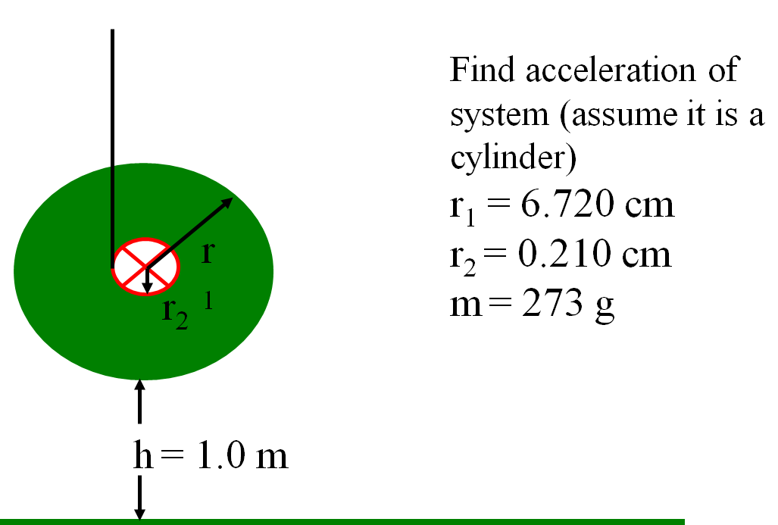
0.0191 m/s/s, 0.196 m/s if h = 1.00 m

Slide 5
μ = 0.110
12.0
kg
7.00
kg
The coeff. of fri
The pulley is a 13.0 cm radius 10.0 kg
cylinder. What is the acceleration of the system if the 12.0 kg mass is sliding to the right?
2.3217 m/s/s

