Slide 1
Angular Mechanics - Torque and moment of inertia
Contents:
Review
Linear and angular Qtys
Tangential Relationships
Angular Kinematics
Torque
Example | Whiteboard
Moment of Inertia D D
Example | Whiteboard
Torque and Moment of inertia
Example | Whiteboard

Slide 2
Tangential Relationships
Linear:
(m) s
(m/s) v
(m/s/s) a
Tangential: (at the edge of the wheel)
= θr - Displacement
= ωr - Velocity
= αr - Acceleration

Slide 3
Angular Quantities
Linear:
(m) s
(m/s) u
(m/s) v
(m/s/s) a
(s) t
(N) F
(kg) m
Angular:
θ - Angle (Radians)
ω_{o} - Initial angular velocity (Rad/s)
ω - Final angular velocity (Rad/s)
α - Angular acceleration (Rad/s/s)
t - Uh, time (s)
Γ - Torque
I - Moment of inertia

Slide 4
Angular kinematics
Linear:
u + at = v
ut + ¹/₂at² = s
u² + 2as = v²
(u + v)t/2 = s
ma = F
Angular:
ω = ω_{o} + αt
θ = ω_{o}t + ¹/₂αt²
ω² = ω_{o}² + 2αθ
θ = (ω_{o} + ω)t/2*
Γ = Iα
*Not in data packet

Slide 5
Torque
Torque A twisting force that can cause an angular acceleration.
So how do you increase torque?
Push farther out:
Push with more force:
F
or
F

Slide 6
Torque
Torque A twisting force that can cause an angular acceleration.
Γ = rxF
F
r
If r = 0.50 m, and F = 80 N, Γ =

Slide 7
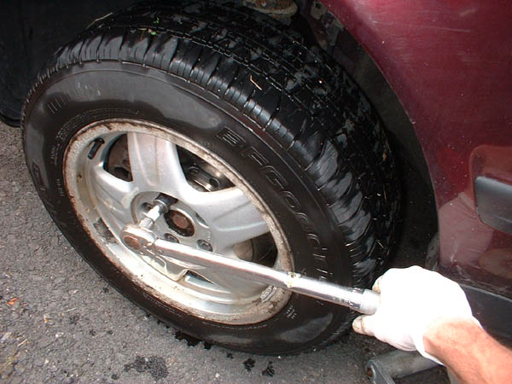

Slide 8
Torque
Torque A twisting force that can cause an angular acceleration.
Γ = rxF = rFsinθ
F
Fsinθ
θ
r
Only the perpendicular component gives rise to torque. (That’s why it’s sinθ)

Slide 9
Example: What’s the torque here?
θ = 56º
F = 16 N
r = 24 cm
Ok – This is as tricky as it can be:
use Γ = rFsinθ, r = 0.24 m, F = 16 N
But θ is not 56º. You want to use the angle between r and F which is 90 – 56 = 34º
Finally, Γ = (.24 m)(16 N)sin(34º) = 2.1 mN

Slide 10
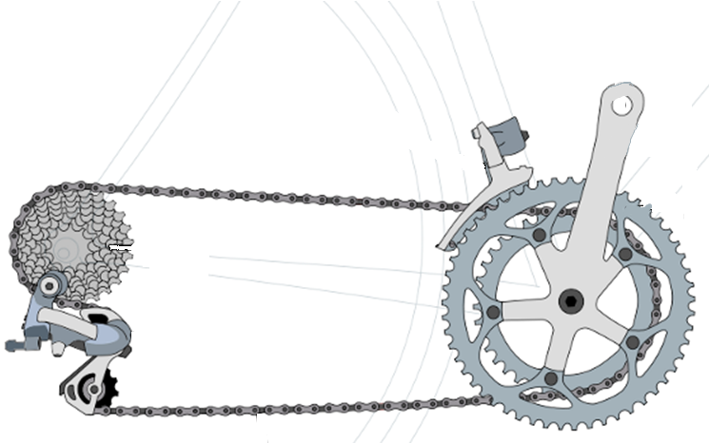
OK, so you know about torque, Which set of gears is easier to use then?

Slide 11
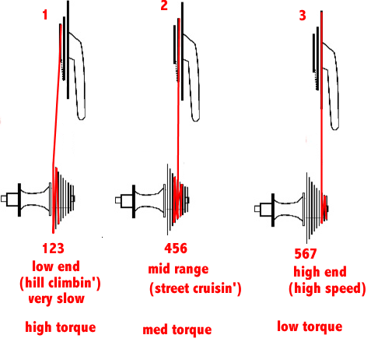
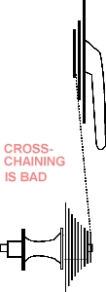
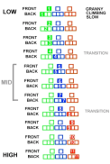
Gears on your bicycle

Slide 12
Whiteboards:
Torque
1 | 2 | 3

Slide 13
What is the torque when you have 25 N of force perpendicular 75 cm from the center of rotation?
Γ = rFsinθ
Γ = (.75 m)(25 N)sin(90º) = 18.75 mN
= 19 mN
19 mN

Slide 14
If you want 52.0 mN of torque, what force must you exert at an angle of 65.0º to the end of a 0.340 m long wrench?
τ = rFsinθ
52 mN = (.34 m)(F) sin(65º)
F =(52mN)/((.34m) sin(65º))=168.75 N
F = 169 N
169 N

Slide 15
The axle nut of a Volkswagen requires 200. foot pounds to loosen. How far out (in feet) from the center do you stand on the wrench if you weigh 145 lbs, and the wrench makes an angle of 21.0º with the horizontal? (Careful what you use for the angle)
τ = rFsinθ, θ =90 - 21 = 69.0º
200. ft lbs = (r)(145 lbs) sin(90º)
r = (200. ft lbs)/(145 lbs)/sin(90º) = 1.4774 feet
r = 1.48 feet (1’ 5.7”)
1.48 feet

Slide 16
Angular Mechanics – Moment of inertia
Moment of Inertia - Inertial resistance to angular acceleration.
Question - If the blue masses were identical, would both systems respond identically to the same torque applied at the center?

Slide 17
Angular Mechanics – Moment of inertia
F = ma - We can’t just use “m” for “I”
Γ = Iα (The position of “m” matters!)
r
F

Slide 18
Angular Mechanics – Moment of inertia
What about a cylinder rotating about its central axis?
Some parts are
far from the axis
Some parts are
close to the axis
In this case,
I = ¹/₂mr²
(You need calculus to derive it)

Slide 19
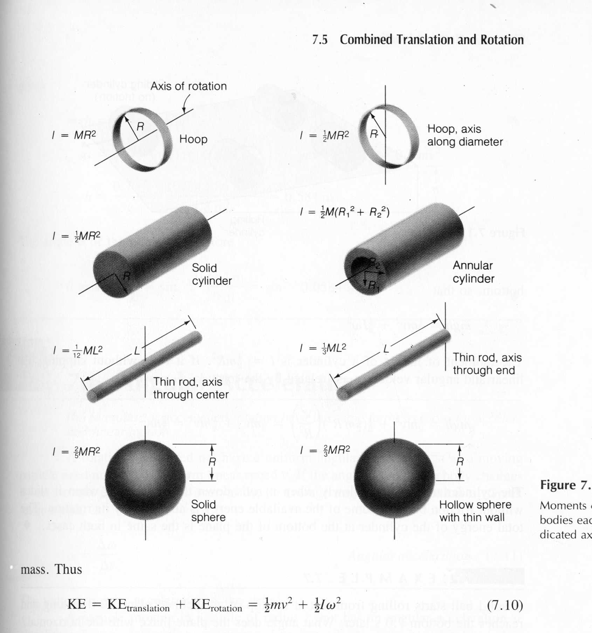
In general, you look them up in your book.

Slide 20
Three main ones:
½mr² - Cylinder (solid)
mr² - Hoop (or point mass)
²/₅mr² – Sphere (solid)

Slide 21
Example: Three 40. kg children are sitting 1.2 m from the center of a merry-go-round that is a uniform cylinder with a mass of 240 kg and a radius of 1.5 m. What is its total moment of inertia?
442.8 kgm²

Slide 22
Whiteboards:
Moment of Inertia
1 | 2 | 3

Slide 23
What is the moment of inertia of a 3.5 kg point mass that is 45 cm from the center of rotation?
0.71 kgm²

Slide 24
A uniform cylinder has a radius of 1.125 m and a moment of inertia of 572.3 kg m². What is its mass?
904.4 kg

Slide 25
A sphere has a mass of 45.2 grams, and a moment of inertia of 5.537 x 10⁻⁶ kg m². What is its radius?
0.0175 m

Slide 26
Angular Dynamics – Torque and moment of inertia
Now let’s put it all together, we can calculate torque and moment of inertia, so let’s relate them:
The angular equivalent of F = ma is:
F = ma
Γ = Iα

Slide 27
Angular Dynamics – Torque and moment of inertia
Γ = Iα

Slide 28
Example: A string with a tension of 2.1 N is wrapped around a 5.2 kg uniform cylinder with a radius of 12 cm. What is the angular acceleration of the cylinder? How many rotations will it make before it reaches a speed of 2300 RPM from rest?
685.86 rev

Slide 29
Whiteboards:
Torque and Moment of Inertia
1 | 2 | 3 | 4 | 5

Slide 30
What torque is needed to accelerate a 23.8 kg m² wheel at a rate of 388 rad/s/s?
9230 mN

Slide 31
An object has an angular acceleration of 23.1 rad/s/s when you apply 6.34 mN of torque. What is the object’s moment of inertia?
0.274 kgm²

Slide 32
If a drill exerts 2.5 mN of torque on a 0.075 m radius, 1.75 kg grinding disk, what is the resulting angular acceleration?
510 rad/s/s

Slide 33
What torque would accelerate an object with a moment of inertia of 9.3 kg m² from 2.3 rad/s to 7.8 rad/s in 0.12 seconds? (1 hint)
430 mN

Slide 34
If you exert 12.0 N tangentially at the edge of a 45.0 kg 72.0 cm diameter cylindrical potter’s wheel, what is its angular acceleration?
1.48 rad/s/s

Slide 35
A merry go round is a uniform solid cylinder of radius 2.0 m. You exert 30. N of force on it tangentially for 5.0 s and it speeds up from rest to 12.9 RPMs. What’s its mass?
110 kg

