Slide 1
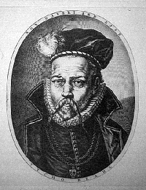
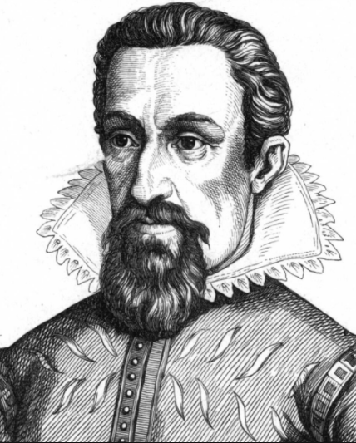
Johannes Kepler 1571 - 1630
Tycho Brahe 1546 - 1601
Kepler’s 3 laws of planetary motion:
1. Orbits are ellipses.
(Central body a focal point)

Slide 2
Johannes Kepler 1571 - 1630
Tycho Brahe 1546 - 1601
Kepler’s 3 laws of planetary motion:
2. Objects sweep equal
area in equal time
(closer = faster)

Slide 3
Johannes Kepler 1571 - 1630
Tycho Brahe 1546 - 1601
Kepler’s 3 laws of planetary motion:
R₂
R₁³ R₂³
T₁² T₂²
3. Period – Radius
(Derive from orbit)
R₁
=

Slide 4
What is the radius of a geostationary orbit (T = 1 day) if for the moon T = 27.4 days, R = 3.8 x 10⁸ m
R₁ = ?? R₂ = 3.8 x 10⁸ m
T₁ = 1 day T₂ = 27.4 days
R₁³ = R₂³
T₁² = T₂²
R₁ = (R₂³/T₂²*T₁²)^{(1/3)} = 41810294 = 4.2 x 10⁷ m
4.2 x 10⁷ m

Slide 5
Mars is 1.524 AUs from the sun. If our year is 365.26 days long, how many earth days is Mars's year?
R₁ = 1.524 AU R₂ = 1.000 AU
T₁ = ??? T₂ = 365.26 days
R₁³ = R₂³
T₁² = T₂²
687.2 days

