Slide 1
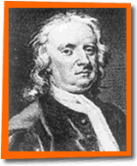
Fundamental Forces

Slide 2
Fundamental forces:
Gravity
Always attractive
Very weak
Acts on all mass
Electro-Magnetic
Attracts/repels
Fairly strong (demo)
Acts on charged particles
Fundamental forces:
Weak Nuclear
Explains certain decays
Acts in the nucleus
Strong Nuclear
Binds Nucleons
Very strong
Very short range
TOC

Slide 3
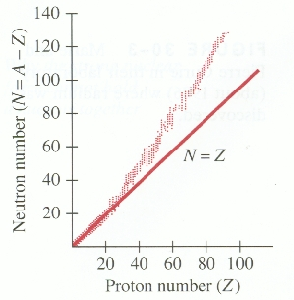
Neutrons glue
massive nuclei
Why there are not an infinite number of elements
TOC

