Slide 1
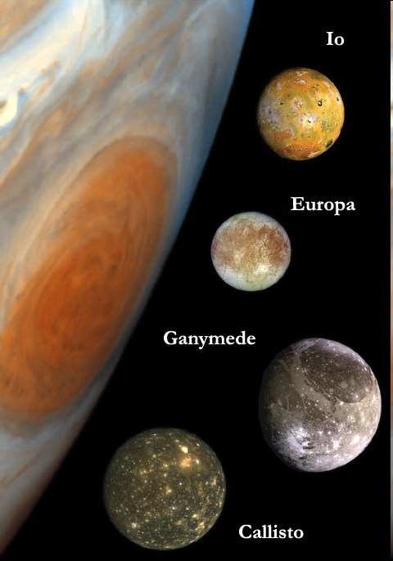
Ganymede and Callisto are both Galilean moons of Jupiter. Ganymede orbits at a distance of 1,070,412 km from Jupiter’s center, and has a period of 7.15 days. What is Callisto’s period of orbit if it has an orbital radius of 1,882,709 km? Use Kepler’s third law:
R₁³ = R₂³
T₁² T₂²
(1,070,412)³/(7.15)² = (1,882,709)³/T², T = 16.67840003 days
16.7 days

