Slide 1
68.4 N

Slide 2
-7.80E2 N

Slide 3
1.3E4 N

Slide 4
3.8 m/s/s

Slide 5
1.0E2 N, 0 N

Slide 6
a (0.98) b (0.91)

Slide 7
73 N

Slide 8
4.1 m

Slide 9
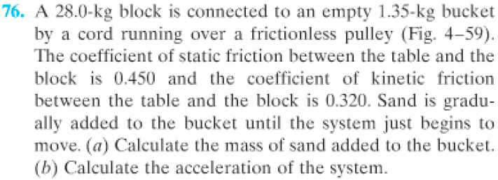
11.3kg, 0.88 m/s/s

Slide 10
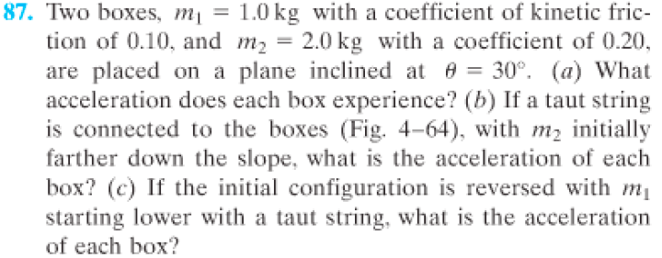
4.1 m/s/s, 3.2 m/s/s, 3.5 m/s/s

Slide 11
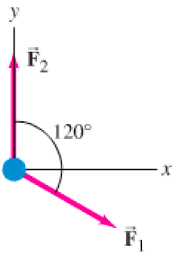
b (14.0 N, 51 degrees, 0.520 m/s/s)

Slide 12
101 N, 0.719

Slide 13
answer

Slide 14
answer

