Slide 1
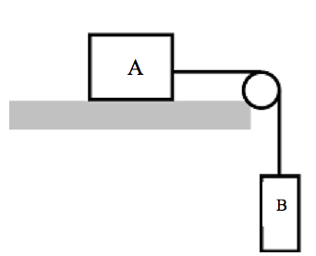
5a. The plane and pulley are frictionless
a) If A has a mass of 23.1 kg, and B has a mass of 5.63 kg, what is the tension in the string, and the acceleration of the system?
a) 44.4 N, 1.92 m/s/s

Slide 2
5b. The plane and pulley are frictionless
b) If A has a mass of 2567 kg, and B has a mass of 1.00 kg, what is the tension in the string, and the acceleration of the system?
b) 9.81 N, 0.00382 m/s²

Slide 3
5c. The plane and pulley are frictionless
c) If A has a mass of 1.00 kg, and B has a mass of 500. kg, what is the tension in the string, and the acceleration of the system?
c) 9.79 N, 9.79 m/s/s

Slide 4
5d. The plane and pulley are frictionless
d) If A has a mass of 35.0 kg, What does B need to be so that the system has an acceleration of 3.15 m/s/s?
d) 16.6 kg

Slide 5
e) If A has a mass of 23.1 kg, and B has a mass of 5.63 kg, what is the tension in the string, and the acceleration of the system if there is a coefficient of friction of 0.0759 between block A and the plane.
e) 47.8 N, 1.32 m/s/s

Slide 6
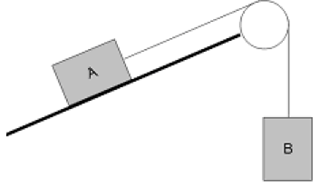
6a The pulley and plane are frictionless
a) If A and B both have a mass of 5.0 kg, and the plane makes an angle of 25º with the horizontal, what is the acceleration and the tension in the cable?
a) 2.8 m/s/s, 35 N

Slide 7
6b The pulley and plane are frictionless
b) A has a mass of 5.0 kg, and B has a mass of 1.78 kg, and the plane makes an angle of 25º with the horizontal. Find the acceleration of the system and tension in the cable
b) -0.48 m/s/s, 18 N

Slide 8
6c The pulley and plane are frictionless
c) Suppose A has a mass of 4.51 kg, and accelerates from rest 3.27 m up the ramp in 1.81 seconds. What must the mass of B be? (use 25.0º)
c) 3.54 kg

Slide 9
6d The pulley and plane are frictionless
d) If the plane angle is 30º and A is 15 kg, what should the mass of B be to prevent acceleration?
d) 7.5 kg

Slide 10
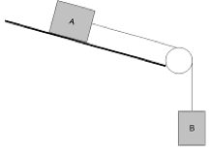
7a. The plane and pulley are frictionless, and the plane makes an angle of 21.0º with horizontal.
a) If A has a mass of 5.00 kg, and B 4.30 kg, what are the acceleration and the tension in the cable?
a) 6.43 m/s/s 14.6 N

Slide 11
7b. The plane and pulley are frictionless, and the plane makes an angle of 21.0º with horizontal.
b) If A has a mass of 3.12 kg, and the tension in the cable is 2.56 N, what must the mass of B be?
b) .468 kg

Slide 12
7c. The plane and pulley are frictionless, and the plane makes an angle of 21.0º with horizontal.
c) Using the masses from part a), suppose you observed an acceleration of only 3.50 m/s/s. What frictional force must exist between A and the plane?
c) 27.2 N

Slide 13
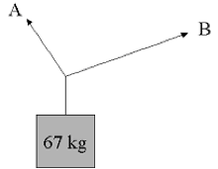
8. Cable A makes an angle of 63.0º with the horizontal, and B makes an angle of 23.0º with the horizontal. What is the tension in each cable for there to be no acceleration of the system?
A = 606 N B = 299 N

Slide 14
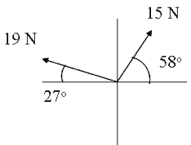
10. Find the third force (the equilibrant) that would prevent the system from accelerating.
23.16 N At 292.8º

Slide 15
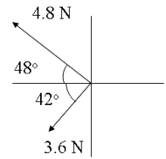
11. Find the third force (the equilibrant) that would prevent the system from accelerating.
6.000 N At 348.9º

